Slide 1
DepEd Financial Management Objective and Framework
CARLO P. DIVEDOR
November 15-17, 2017

Slide 2
Financial Management Objective
FMOM as implementation guide
This FMOM serves as a reference material for Officials, Employees, and other interested public and private stakeholders of the DepEd. This is a big leap towards the eventual integration and automation of government financial systems. This intention was expressed with the issuance of Executive Order (E.O.) No. 55 dated 06 September 2011 (presently on temporary suspension). The E. O. promotes reform towards improving the system of safeguarding assets for optimum utilization.

Slide 3
Financial Management Objective
FMOM as support for process effectiveness and efficiency
Maintaining a solid and operative Public Financial Management system requires support for its continued effectiveness and efficiency. DepEd has embarked on creating this FMOM as a guide for their officers, employees, particularly its financial managers and staff, and other interested parties.

Slide 4
Financial Management Objective
FMOM as a tool for good governance
Good governance entails proper fiscal discipline. There is an increasing realization that PFM, as a measure for the government's overall fiscal discipline, should ensure that the allocation of resources to priority needs is optimal.
The FMOM clearly defines the appropriate financial systems and procedures, ensuring sound control mechanisms are in place.

Slide 5
Financial Management Objective
FMOM as an Instrument for Transparency and Accountability
The quality of decisions made for the use of public funds must adhere to the precepts of Transparency and Accountability that are interdependent variables in quality decision-making.
The FMOM is DepEd's leverage in its commitment for transparency and accountability to ensure the effective use of public internal and external resources.

Slide 6
Financial Management Objective
DepEd's Organizational structure based on RA 9155 (Governance of Basic Education Act of 2001) and revised by EO 366 (Rationalization Plan of 2004)
To operationalize decentralization as provided under RA 9155, the hierarchical structure and functions of DepEd across all services and covering all levels is distinctly defined. The structure depicts the line of authority and span of control that identifies the responsibilities of its personnel. It provides guidance and clarity on the deployment and utilization of education resources. As specified in the law, it also "defines the roles and responsibilities of and provides resources to the field offices which shall implement educational programs, projects and services in communities they serve

Slide 7
Financial Management Objective
DepEd's Organizational structure based on RA 9155 (Governance of Basic Education Act of 2001) and revised by EO 366 (Rationalization Plan of 2004)
A review of the operations and organizational structure of government brought about the 'Rationalization Plan' as directed in E.O. No. 366 s. 2004. To give more alignment throughout the organization, further review and revision of DepEd's Rationalization Plan was continued in CY 2011 until its approval on 15 November 2013 by DBM. DepEd Order No. 52 s. 2015 dated October 30, 2015 prescribed the new organizational structures of the DepEd Central, Regional, and Schools Division offices.

Slide 8
Financial Management Structure
DepEd's financial management structure covers all of the Offices (Central, Regions, Divisions and Schools). Authority, responsibility and accountability are inherent in the key positions created to discharge specific duties and tasks related to financial management

Slide 9
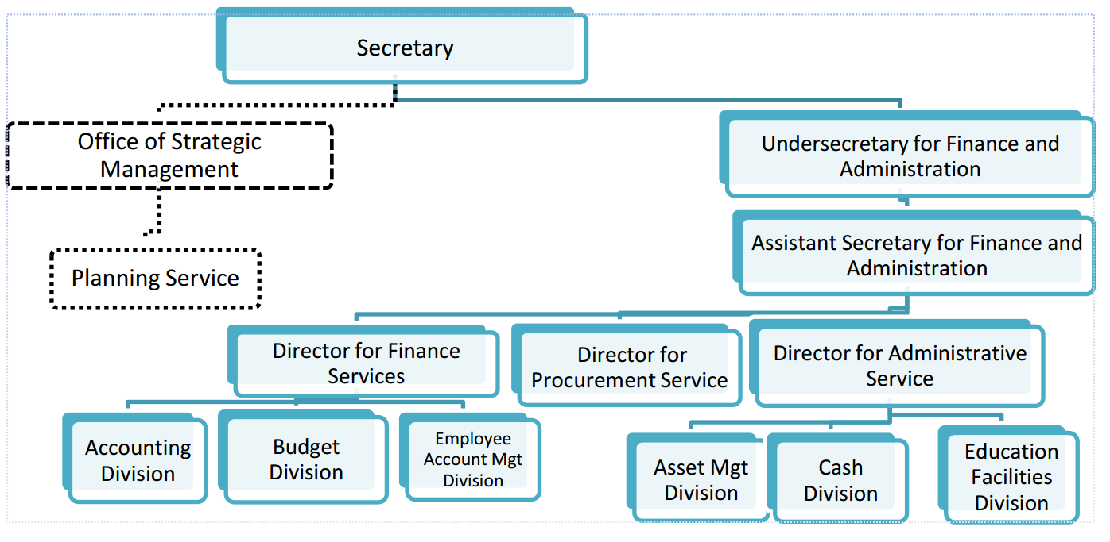
Financial Management Structure
Central Office

Slide 10
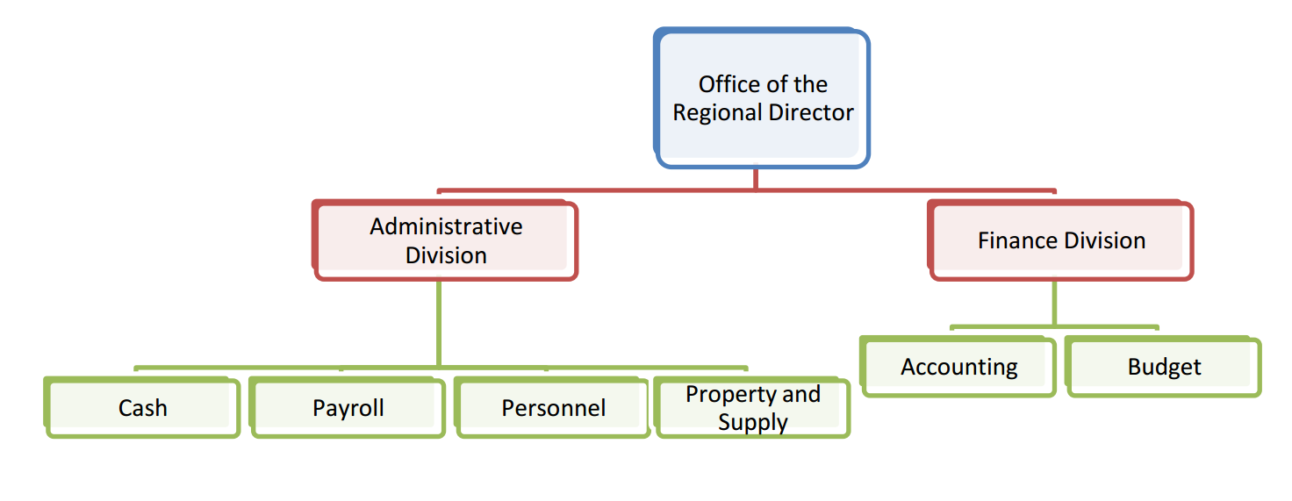
Financial Management Structure
Regional Office

Slide 11
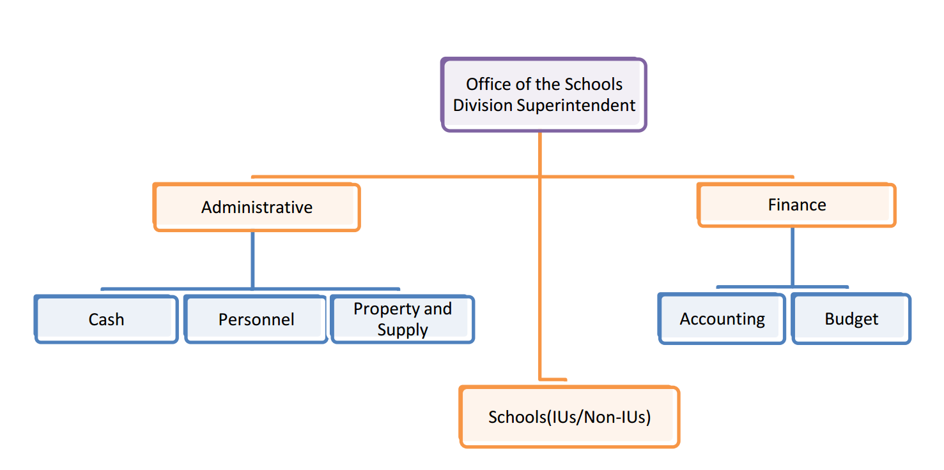
Financial Management Structure
Division Office

Slide 12
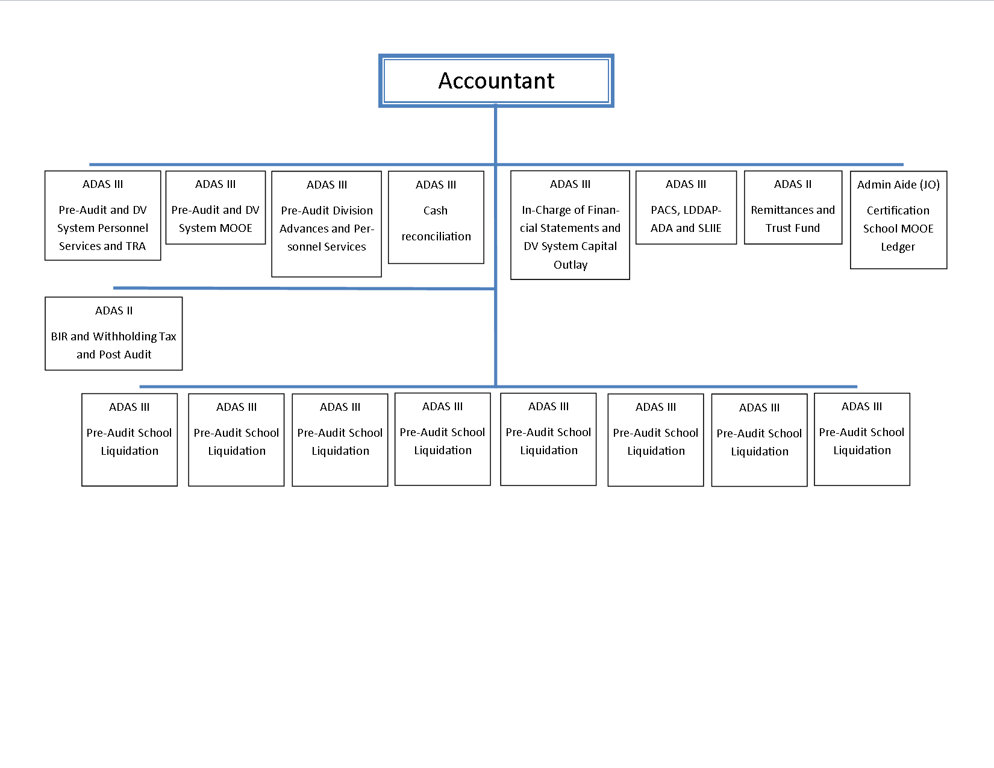
Financial Management Structure
Division Office Accounting Unit

Slide 13
Financial Management Structure
The Secretary exercises overall supervision and control over the entire department. Notwithstanding the primary authority of the Secretary over all financial transactions, delegation of financial signing authority down to the lowest unit of the organization is properly laid down in DepEd Order No. 67, 2016.

Slide 15
Simplified Accounting Manual
DepEd Order No. 72 s. 2008 Manual on Simplified Accounting Procedures for Non Implementing Unit
As part of Financial Reform of the Department on School-Based Management (SBM) under the Basic Education Sector Reform Agenda (BESRA), a Manual on Simplified Accounting Procedures for Non-Implementing Units was developed and approved by the Commission on Audit (COA), Central Office on December 2, 2008.

Slide 16
Simplified Accounting Manual
DepEd Order No. 72 s. 2008 Manual on Simplified Accounting Procedures for Non Implementing Unit
This Manual shall serve as the implementing guidelines of the Memorandum from Undersecretary Ramon C. Bacani dated May 14, 2008 and Unnumbered Memorandum from Undersecretary Teodosio C. Sangil, Jr. dated June 4, 2008 (copies enclosed) regarding the receipt, utilization and liquidation of cash advances received by School Heads of Non-IUs from Division Offices for Schools’ Maintenance and Other Operating Expenses (MOOE), SBM Grants, etc.

Slide 17
Legal Basis
DepEd Order No. 13 2. 2016 IMPLEMENTING GUIDELINES ON THE DIRECT RELEASE AND USE OF MAINTENANCE AND OTHER OPERATING EXPENSES (MOOE) ALLOCATIONS OF SCHOOLS, INCLUDING OTHER FUNDS MANAGED BY SCHOOLS
It is based on the following legal bases; i) Department of Budget and Management (DBM) and DepEd Joint Circular No 2004-1 dated January 01, 2004, entitled “Guidelines on the Direct Release of Funds to DepEd-Regional Offices and Implementing Units”, and ii) Section 10, Republic Act No. 9155 (Governance of Basic Education Act of 2001), which provides that the appropriations intended for the regional and field offices (elementary/secondary schools and Schools Division Offices [SDOs]) are to be allocated directly and released immediately by DBM to the said offices.

Slide 18
Legal Basis
DepEd Order No. 13 2. 2016 IMPLEMENTING GUIDELINES ON THE DIRECT RELEASE AND USE OF MAINTENANCE AND OTHER OPERATING EXPENSES (MOOE) ALLOCATIONS OF SCHOOLS, INCLUDING OTHER FUNDS MANAGED BY SCHOOLS
This DepEd Order aims: i) to provide guidance to all public schools on the derivation, release and the utilization of school MOOE; ii) to ensure timely and optimal use of school resources, and iii) to institute mechanisms for transparency and accountability.
This DepEd Order provides the mechanisms, procedures, and standards for the release, utilization and liquidation of School MOOE of all public elementary schools, junior and senior high schools nationwide. This also defines the roles and responsibilities of each level of governance in managing school MOOE.

Slide 19
Legal Basis
DepEd Order No. 13 2. 2016 IMPLEMENTING GUIDELINES ON THE DIRECT RELEASE AND USE OF MAINTENANCE AND OTHER OPERATING EXPENSES (MOOE) ALLOCATIONS OF SCHOOLS, INCLUDING OTHER FUNDS MANAGED BY SCHOOLS
The DepEd hereby establishes the mechanisms, procedures and standards in the utilization of school MOOE that shall be followed strictly by all public elementary, junior and senior high schools in the country. This policy also promotes equity, transparency and accountability.

Slide 20
Legal Basis
DepEd Order No. 31 2. 2016 Implementing Guidelines on the Release of Maintenance and Other Operating Expenses (MOOE) Allocations of Senior High Schools
It is based on the following legal bases: (i) Department of Budget and Management (DBM) and DepEd Joint Circular No 2004-1 dated January 01, 2004, entitled “Guidelines on the Direct Release of Funds to DepEd-Regional Offices and Implementing Units”, (ii) Section 10, Republic Act No. 9155 (Governance of Basic Education Act of 2001), which provides that the appropriations intended for the regional and field offices (elementary/secondary schools and Schools Division Offices [SDOs]) are to be allocated directly and released immediately by DBM to the said offices, and (iii) Section 11, Republic Act No. 10533 (Enhanced Basic Education Act of 2013), which provides that appropriations for the operationalization of the enhanced basic education be included in the Department’s budget.

Slide 21
Legal Basis
DepEd Order No. 31 2. 2016 Implementing Guidelines on the Release of Maintenance and Other Operating Expenses (MOOE) Allocations of Senior High Schools
The budget for SHS school MOOE was computed based on: (i) a per capita cost derived from the rationalized formula for school MOOE applied to Junior High Schools in 2016, and (ii) on the projected enrolments contained in the Schools Division SHS Implementation Plans as of September 2015.
Considering that schools will need to mobilize and prepare for the opening of classes in June and that data on actual enrolment will be available in July, the DepEd shall release an initial tranche of funds in May 2016. This amount corresponds to the estimated funding requirements of schools for three (3) months or from June to August 2016. The list of schools and their first tranche allocations are detailed in Annex A and shall be available on the DepEd website.

Slide 22
Legal Basis
DepEd Order No. 31 2. 2016 Implementing Guidelines on the Release of Maintenance and Other Operating Expenses (MOOE) Allocations of Senior High Schools
School MOOE allocations of all public SHS, such as SHS in existing junior high schools, SHS within elementary schools and stand-alone SHS in new sites, regardless if they are implementing units or non-implementing units , shall be released through sub-allotment release order (sub-ARO) to the Schools Division Offices (SDOs).
The Central Office shall calibrate and make adjustments on the second downloading of funds once data on actual enrollment for School Year 2016- 2017 is available on the Learner Information System (LIS). If actual enrollment in the SHS is higher than estimated, additional funds will be released. If actual enrollment is less than estimated, the next tranche of funds shall be adjusted downward accordingly.

Slide 23
THANK YOU

