Slide 1

Enhanced SIP, SRC, & RPMS Integration

Slide 2
School Effectiveness Division Charter
Purpose: The School Effectiveness Division supports and enables schools to continuously improve its own governance and delivery of quality basic education services that are responsive to the diverse needs of its learners.
Summary of Functions/Scope:
Formulation of School Effectiveness Framework
Establishment of standards for governance to support effective schools
Application and monitoring of school performance management standards
Accreditation of Schools and Learning Centers

Slide 3
Overview of Current Thrusts
School Effectiveness Framework
Continuing the School-Based Management Initiatives
  District Synthesis
  School Governing Council
  User Guide on SBM Assessment
  External Accreditation of Schools
  School Re-structuring using School Typology
  School Process Improvements using Continuous Improvement Program
  School Improvement Planning and School Report Card

Slide 4
Policy Bases
The SIP is a roadmap that lays down specific interventions that a school, with the help of the community and other stakeholders, will undertake within a period of three consecutive school years.
D.O. 44, s. 2015
The School Report Card is a tool for advocating and communicating the school situation, context, and performance to internal and external stakeholders
D.O. 44, s. 2015
The RPMS shall align the performance targets and accomplishments with the DepEd’s mandate, vision, mission and strategic goals… The OPCRF shall reflect the Office KRAs, Objectives and performance indicators
D.O. 2, s. 2015

Slide 5

Features of Self-Managing Schools
The learner is at the center of everything we do
Photo from UNICEF Website

Slide 6

Features of Self-Managing Schools
Investment addresses various needs of learners

Slide 7
Features of Self-Managing Schools
Maximizes its intellectual
and social capital

Slide 8

Features of Self-Managing Schools
School governance is participatory

Slide 9

How can schools become effective organizations?

Slide 10

DepEd Order 44, s. 2015

Slide 11
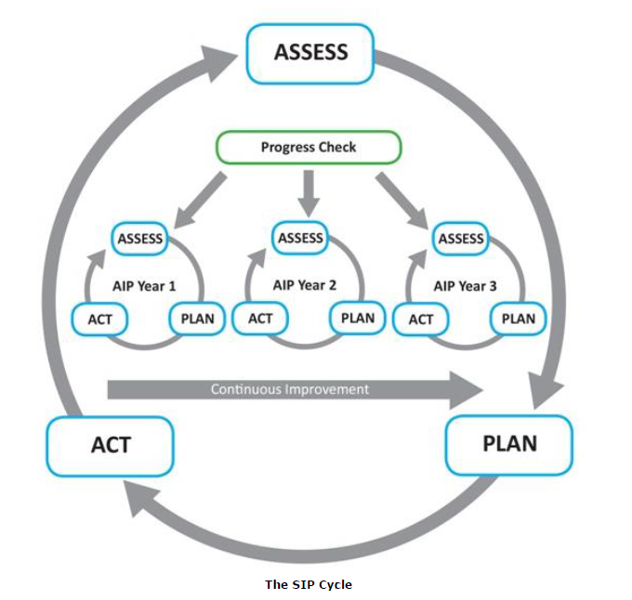
Enhanced SIP Cycle
Plan Monitoring and Evaluation
Situation Analysis
Identification of Strategies,
PAPs, Resource Requirements
Plan Implementation

Slide 12
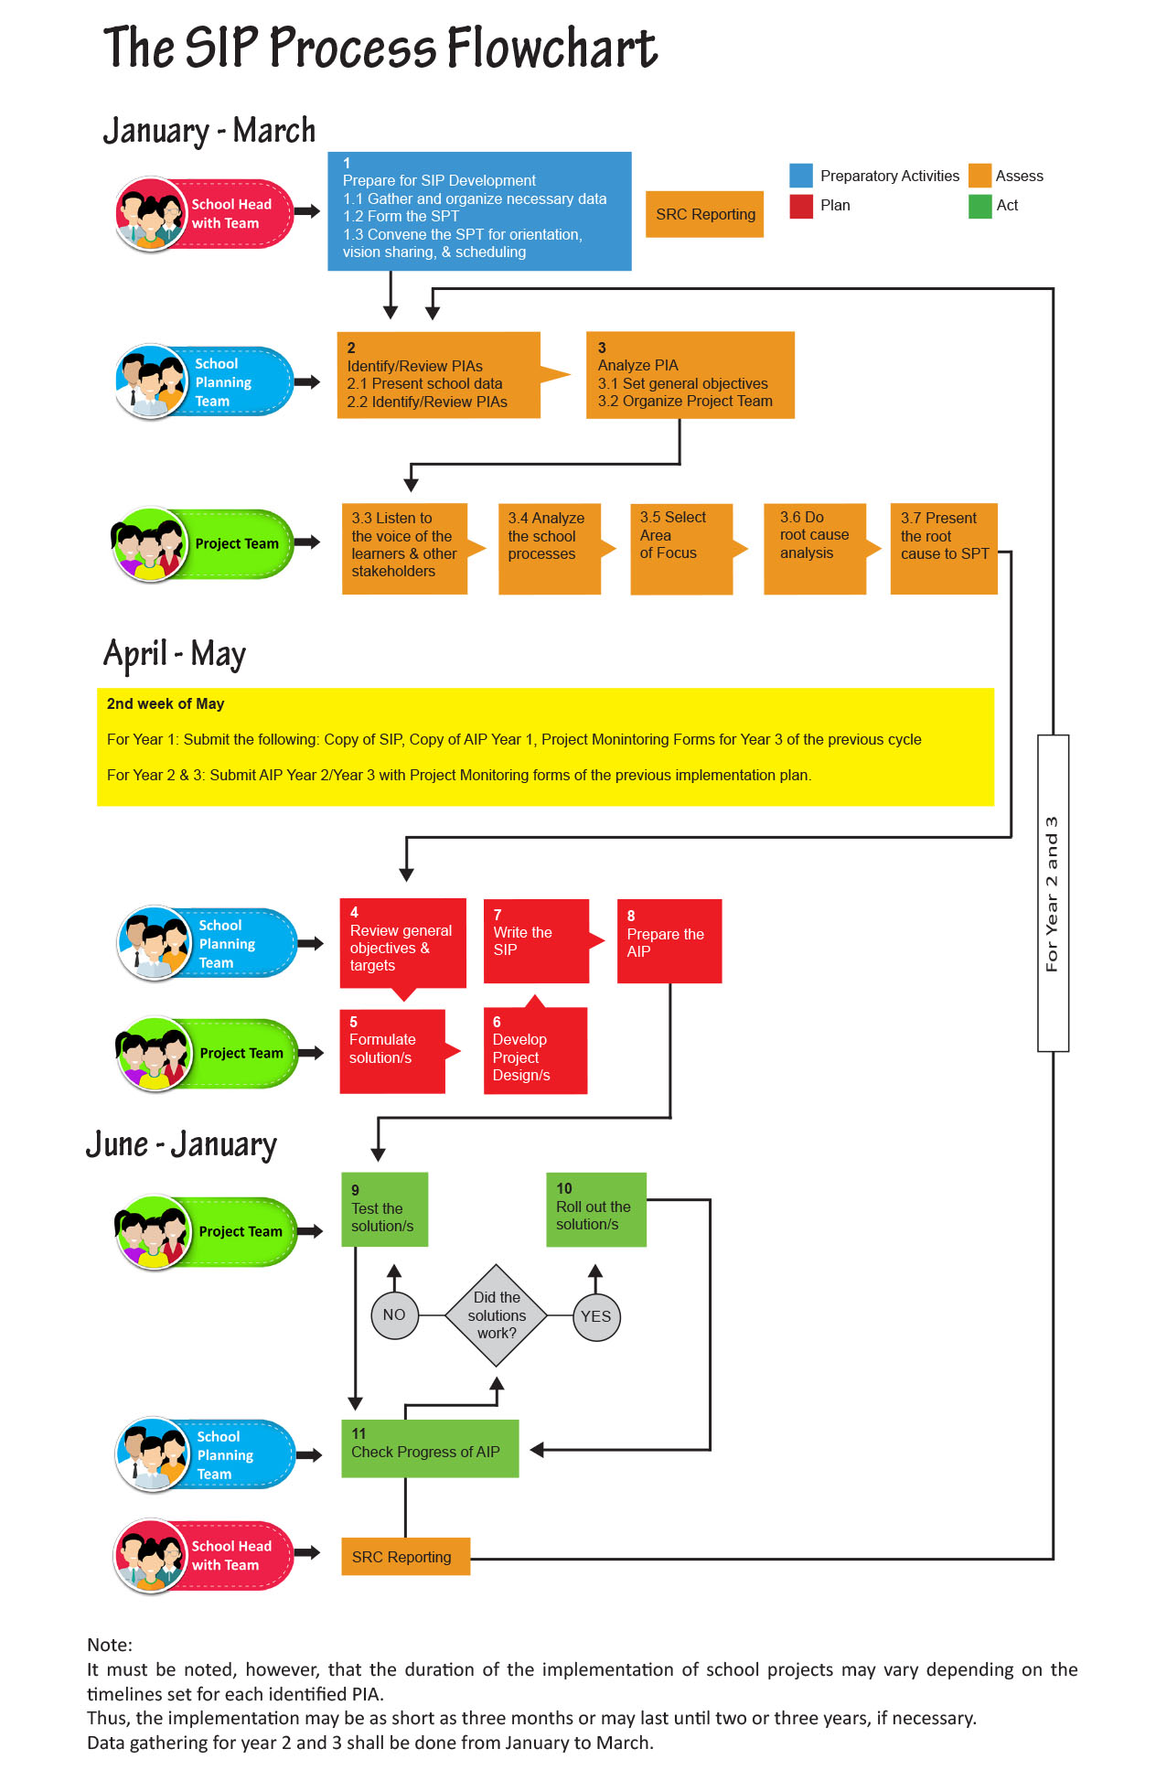

Slide 13
Enhanced SIP Process
Integrated Policies
A. Preparatory Activities
Gather and organize necessary data
Form the SPT
Convene the SPT for orientation, vision sharing and scheduling
Child Protection Policy
D.O. No. 40 s. 2012
Early Registration
D.O. No. 1 s. 2015
B. Assess
Identify/Review PIAs
Analyze PIAs
  Listen to the voice of the learners
  Analyze school proceses
  Select Area of Focus
  Do root cause analysis
Present the root cause to the SPT
Student-Led School Watching and Hazard Mapping
D.O. No. 23 s. 2015
Result-Based Performance Management System
D.O. No. 2 s. 2015
C. Plan
Review general objectives & targets
Formulate solutions
Develop Project Designs
Write the SIP and prepare the AIP
D. Act
Test and roll out the solution/s
Communicating with stakeholders
Check progress of AIP
SBM Assessment
D.O. No. 83 s. 2012

Slide 14
SIP is linked with BEPS via Intermediate Outcomes

Slide 15

Results-based Performance
Management System (RPMS)
How can schools become effective organizations?

Slide 16
RPMS Linkages to Other HR Systems
Agency Planning and and Directions
(SIP, DEDP, REDP, Natl Plan)
Career Succession
HR Planning and Recruitment
RPMS
Training and Manpower Development
Job Design and Work Relationships
Rewards and Recognition
Compensation and Benefits
Employee Relations

Slide 17

The DepEd RPMS is aligned with the CSC SPMS that has 4 Phases.
4 RPMS PHASES
Input: SIP, PIA
I. Performance Planning & Commitment
Output: IPCRF and OPCRF
During adjustment
Output: Development plan
IV. Performance Rewarding and Development Planning
II. Performance Monitoring & Coaching
Output: Monitoring Form
III. Performance Review & Evaluation
Output: Rating sheet

Slide 18
SIP and OPCRF
Major Final Output (MFO) | Key Result Areas (KRAs)/ Priority Improvement Areas OPCRF (Principal) | Key Result Areas (KRAs) IPCRF (Head Teacher) | Key Result Areas (KRAs) IPCRF (Master Teacher) | Key Result Areas (KRAs) IPCRF (Teachers)
Basic Education Services | 1. Instructional Leadership | 1. School Curriculum Monitoring and Evaluation Plan | 1. Instructional Supervision 2. Instructional Competence | 1. Teaching Learning Process
 | 5. Human Resource Management and Development | 5. Human Resource Management (School Based INSET) | 5. Personal and Professional Development (Action Research) | 5. Personal and Professional Development
Key Results Area = Priority Improvement Area

Slide 19
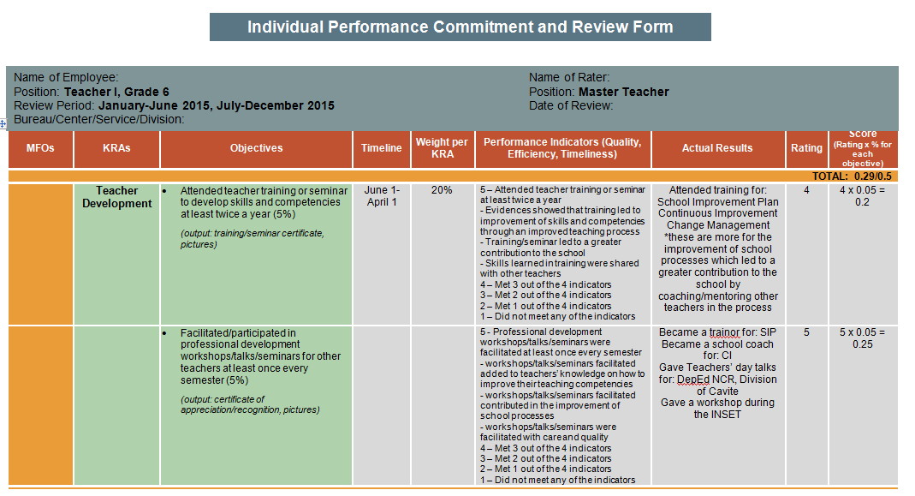

Slide 20
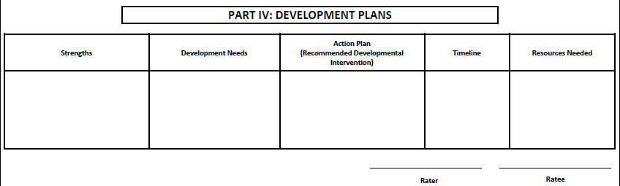
Discuss Strengths and Improvement Needs

Slide 21
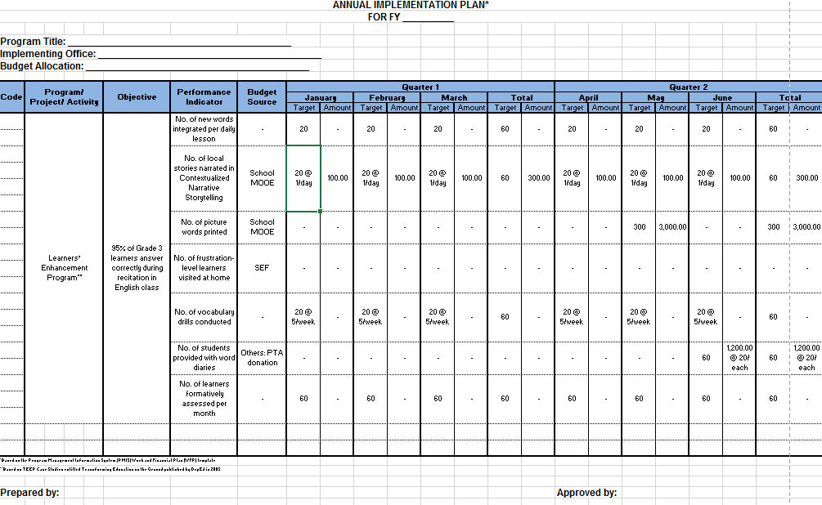

SIP-OPCRF-AIP Integration
1
2
3
SIP
OPCRF
AIP/WFP

Slide 22
Annual Implementation Plan
Adopts the WFP format of Program Management Information System (PMIS)
Follows Fiscal Year Calendar (plus 1st quarter of the succeeding FY)
AIP/WFP is the basis for Monthly Disbursement Program and Annual Procurement Plan

Slide 23
Annual Implementation Plan
Q1 + Q2

Slide 24
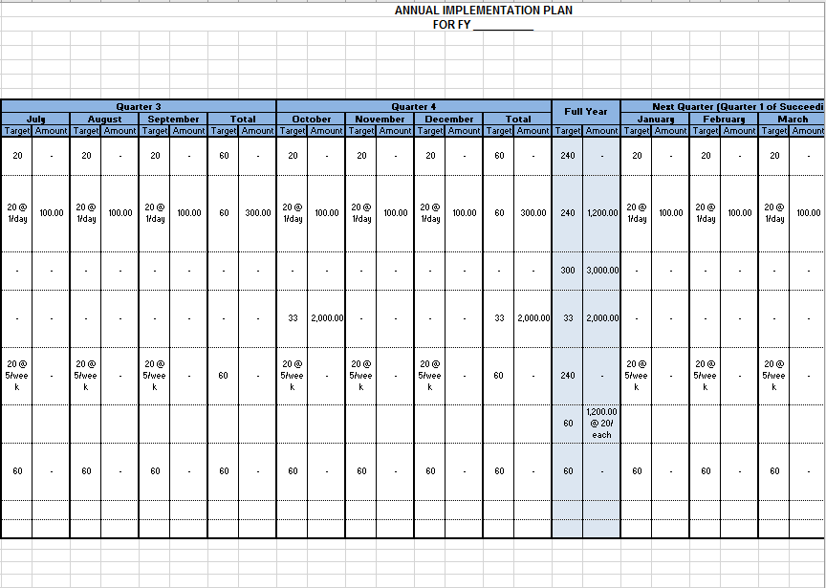
Annual Implementation Plan
Q3 + Q4 + Q1

Slide 25
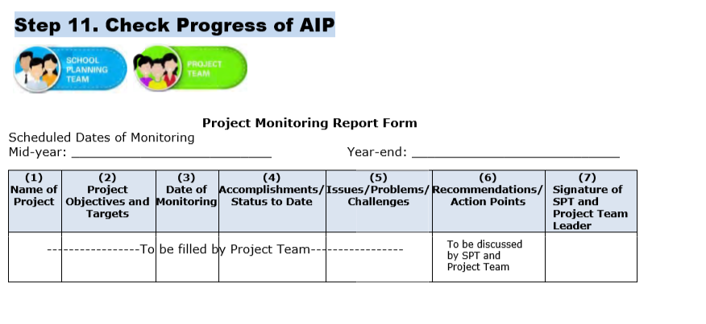
SIP Monitoring

Slide 26

For the first two years of SHS implementation, Senior High Schools are required only to develop AIP/WFP.
FY 2016 AIP/WFP shall include preparatory activities, spill-over activities from previous years and centrally-led projects and activities.

Slide 27

Communicating to stakeholders

Slide 28

School Report Card (DO 44, s. 2015)
OBJECTIVE
To increase community participation and involvement in school operations and activities by providing stakeholders a snapshot of the status of the school and advocating for areas that need their involvement

Slide 29
SRC is aligned with FOI EO
“Every Filipino shall have access to:
Information
Official records
Public records and to
Documents and papers pertaining to official acts, transactions or decisions,
Government research data used as basis for policy development”
- Section 3, Executive Order 02, s. 2016

Slide 30

Features of Refined SRC
Focus is on advocacy and communication;
Streamlined indicators (19 indicators, not 32).
Includes school accomplishment of other stakeholders.
Integrated with SIP

Slide 31




Benefits of using enhanced SRC
Greater stakeholder participation in school activities
Better understanding of stakeholders on school situation
Transparency of school activities and performance

Slide 32




Ways of Disseminating the SRC
Presentation to stakeholders during School Meetings and Assemblies (October & March)
Posting of SRC in school/Division websites, bulletin boards, and other public areas
Allocating space in School Journal or Newsletter
Reproduction of enough copies for distribution to the general public

Slide 33
19 SRC Indicators
SCHOOL PROFILE [6]
PERFORMANCE INDICATORS [11]
STATUS OF SCHOOL PROJECTS [2]
Enrolment
Health and Nutritional Status
Learners materials’
Teachers’ professional development
Funding sources
School awards and recognitions
Access
  Number and rate of dropouts by cause
Quality
  Percentage of learners who completed the School Year (Promotion Rate)
  National Achievement Test (NAT) – by Mean Percentage Score (MPS)
  Literacy level
Governance
  School-Based Management Assessment Level
  Child-Friendly School Survey result
  Stakeholders’ participation
  Learner-Teacher ratio
  Learner-Classroom ratio
  Learner-Toilet ratio
  Learner—Seat ratio
Status of Annual Improvement Plan (AIP)/Continuous Improvement Projects)
Other Stakeholders' Accomplishments

Slide 34

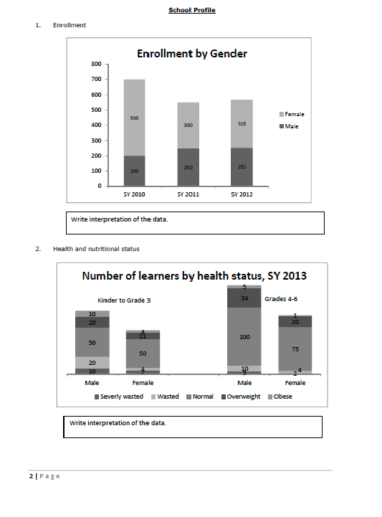
Basic SRC Template

Slide 35
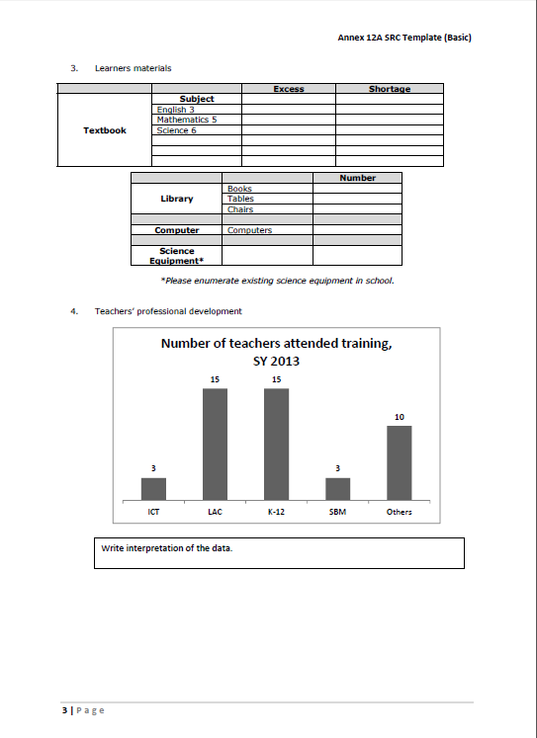
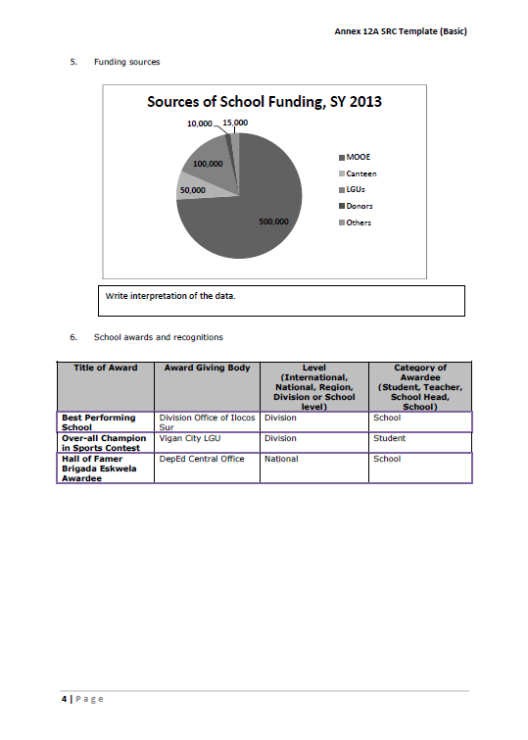
Basic SRC Template

Slide 36

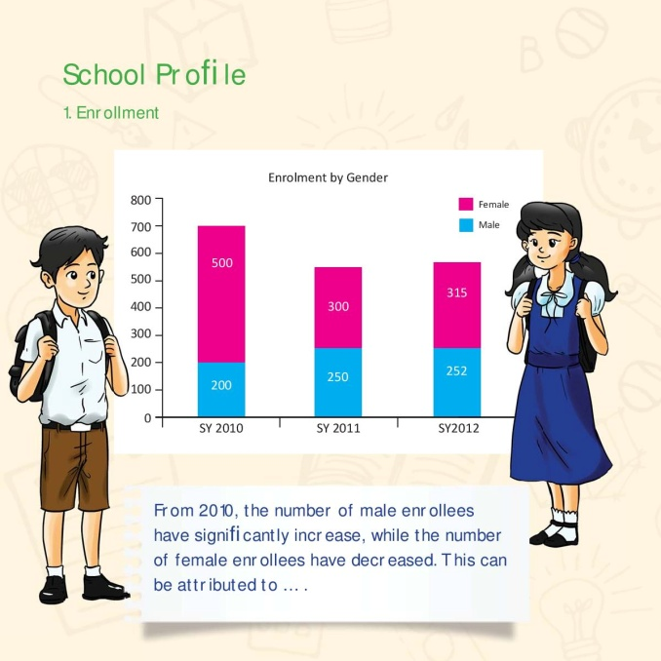
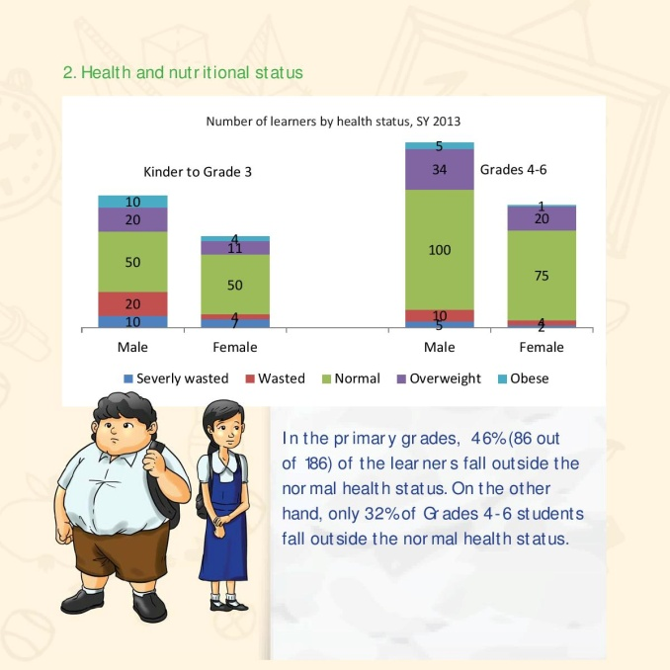
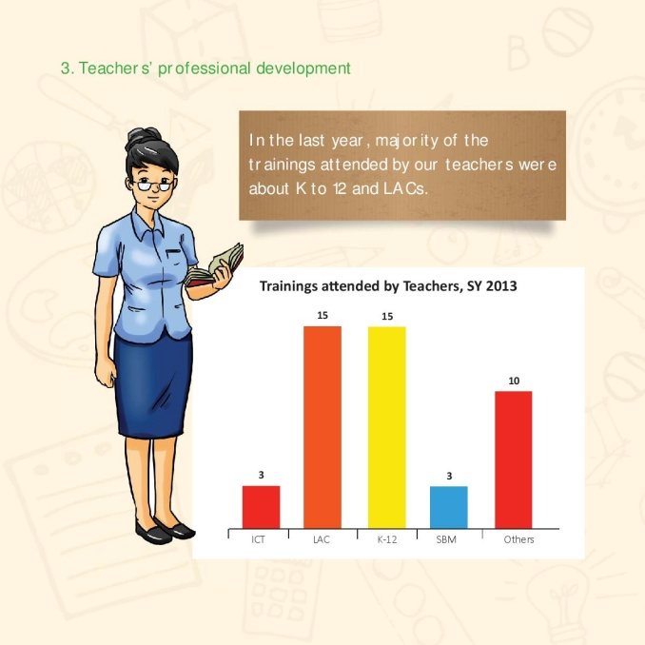
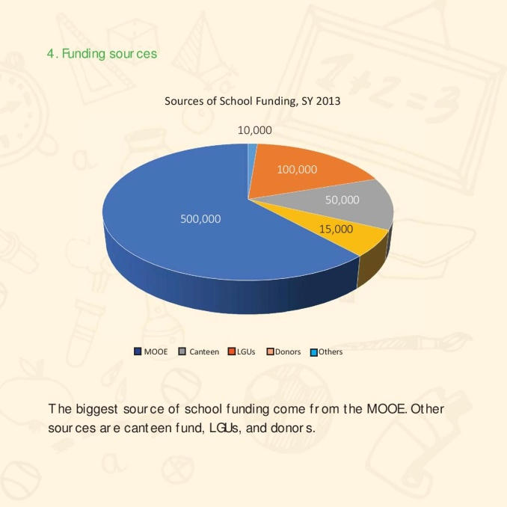

Advanced SRC Templates
BOOKLET

Slide 37
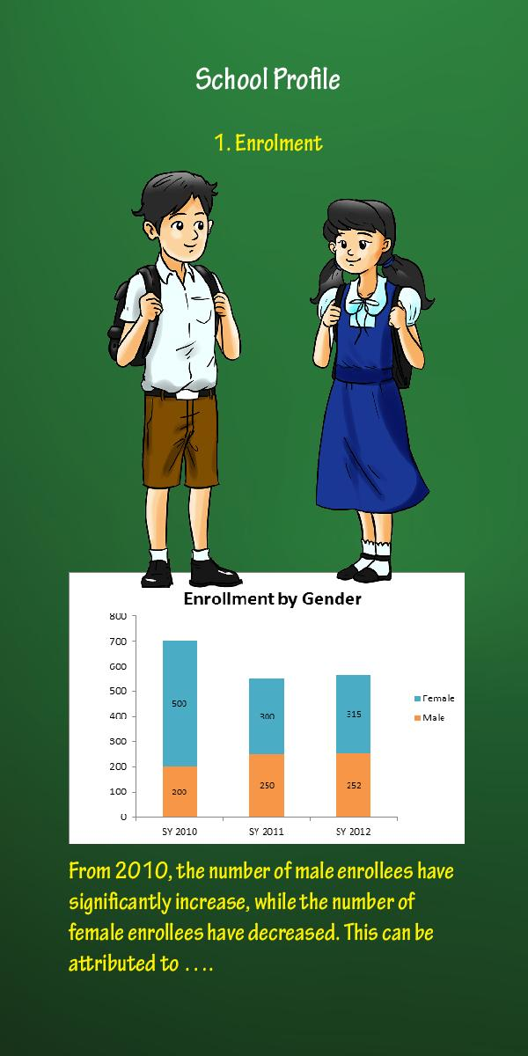



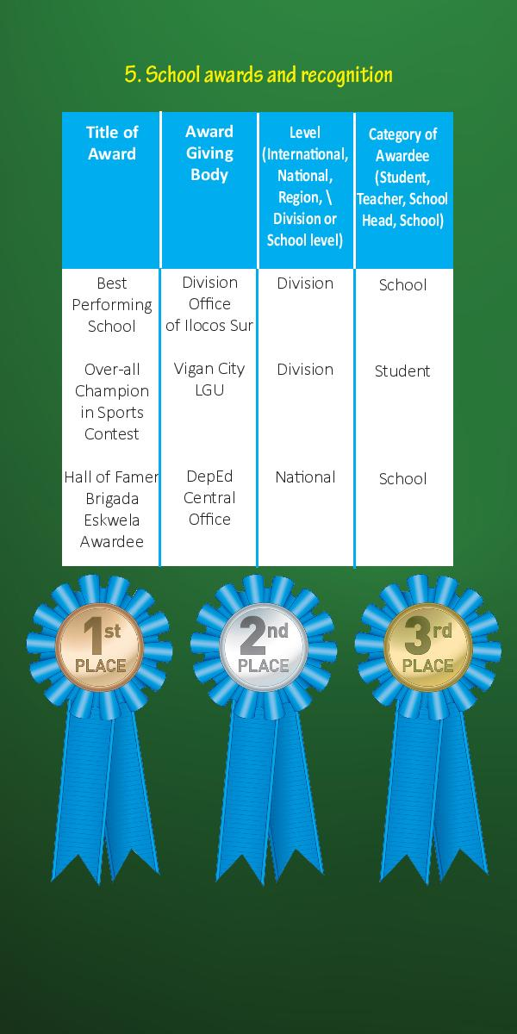
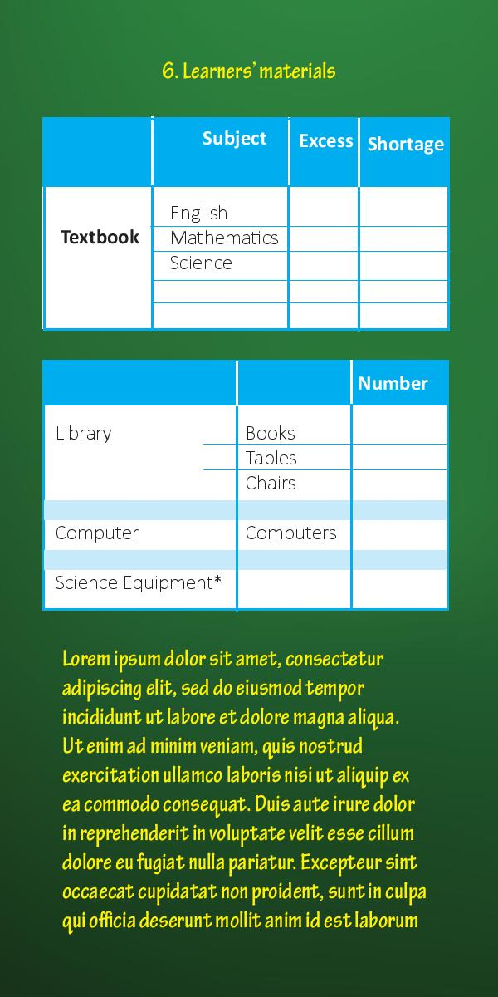
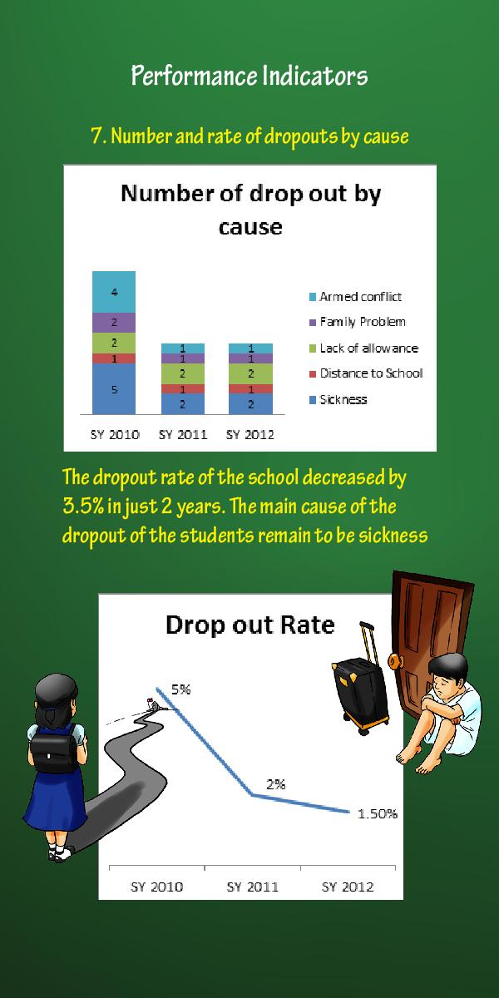
Advanced SRC Templates
BROCHURE
Notes:
Talking points:
The Advanced SRC Templates come in 3 kinds:
Booklet
Brochure
Poster
We will provide the schools with the icons if they opt to use the advanced template. This, however, is not intended to limit the schools’ ability to
create their own SRC. This is merely a guide/sample. With the help of the icons, they may come up with their own layout/style that best reflects
their school.

Slide 38
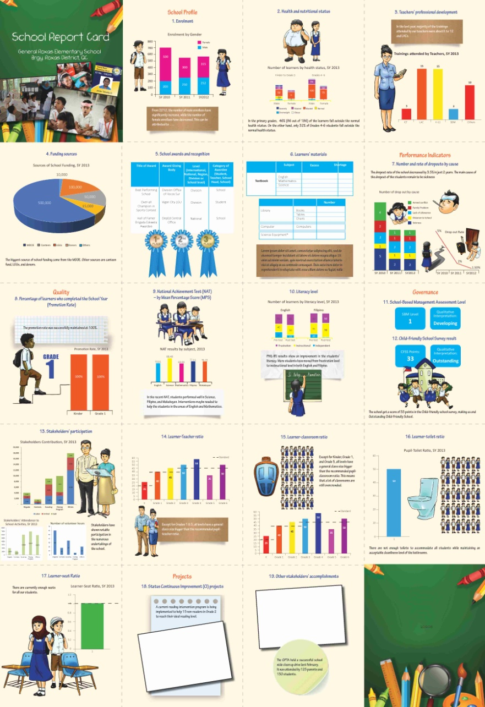
Advanced SRC Templates
Poster
Weblink for SRC Templates & Infographics:
bit.ly/sip_src_templates

Slide 39
Navotas NHS
SCHOOL REPORT CARD
2016 – 2017

Slide 40
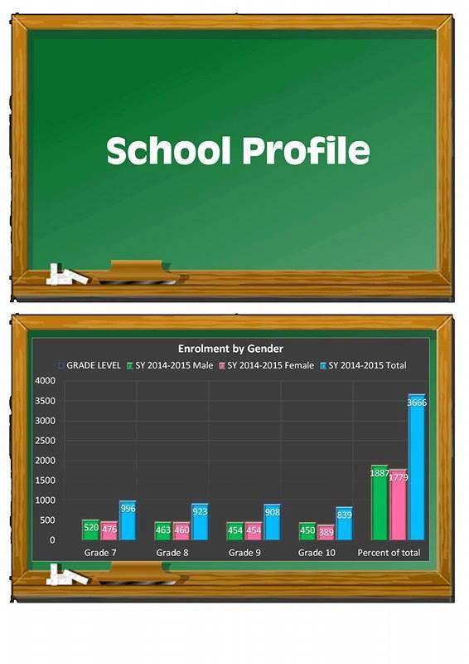
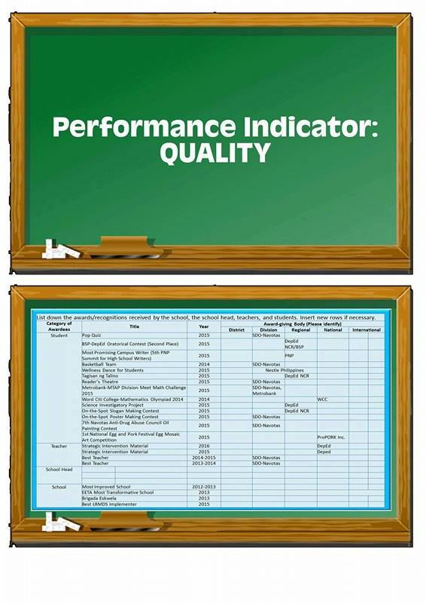
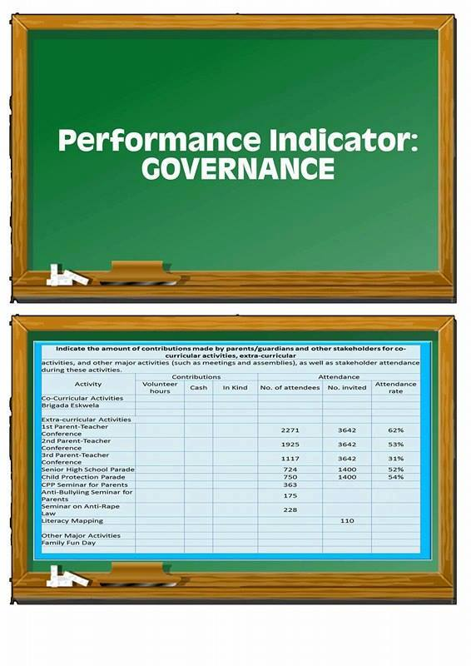
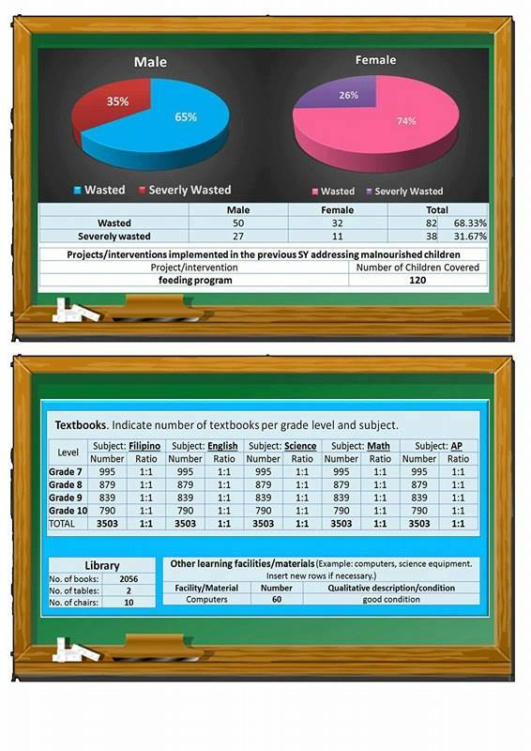



Navotas NHS SRC

Slide 43



Any 1 LM per subject = 1 Learner

Slide 44
Fund Source | Amount
MOOE | PhP 3,468,000.00
GAA | NONE
LGU | NONE
Canteen Funds | 40% of the Canteen Shares

Slide 45
Title of Award | Award Giving Body | Level | Category
Best LRMDS Implementer | DepEd SDO-Navotas | Division | School
Metrobank-MTAP Regional Meet Math Challenge 2015 (3rd Place) | Metrobank, DepEd NCR | Regional | Student
National Science Quest -SIM | DepEd | National | Teacher

Slide 49
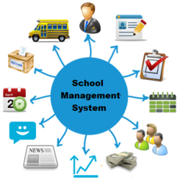
SBM Level
ON GOING

Slide 50


Child-Friendly School
Survey Results
Child Friendly

Slide 51
Schedule of SRC Reporting
DepEd Order 44, s. 2015 –
  School Report Card shall be reported twice in a School Year during months of October and March
  SIP and SRC activities may be included in the Results-Based Performance Management System (RPMS)
DepEd Order 23, s. 2016 – School Calendar SY 2016-2017

Slide 52
Schedule of SRC Presentation
Activity | 2016 | 2017
Preparation of School Report Card | Sept 15-30 | Feb 15-28
Presentation of SRC in school assemblies | Oct 1-14 | Mar 1-11
Submission of school feedback on SRC use | Oct 7-14 | Mar 7-11
GIVE FEEDBACK USING:
bit.ly/src_monitoring_form

Slide 53
End of Presentation
bhrod.sed@deped.gov.ph

