Slide 1
Regulatory Requirements
The Farm @ Carpenter Hill, Koronadal City October 3-4, 2017

Slide 2
DepEd Order No. 15, s. 2017
GUIDELINES ON THE ALLOCATION OF FUNDS FOR VENUE, MEALS AND SNACKS, AND ROOM ACCOMMODATION FOR OFFICIAL ACTIVITIES ORGANIZED AND CONDUCTED BY THE DEPARTMENT OF EDUCATION
Allowable rates for meals which are less than one day or for activities which do not require three meals
Meal | Rate
Breakfast | P 150.00
Snacks (a.m./p.m.) | P 75.00
Lunch/Dinner | P 350.00

Slide 3
DepEd Order No. 15, s. 2017
GUIDELINES ON THE ALLOCATION OF FUNDS FOR VENUE, MEALS AND SNACKS, AND ROOM ACCOMMODATION FOR OFFICIAL ACTIVITIES ORGANIZED AND CONDUCTED BY THE DEPARTMENT OF EDUCATION
For activities utilizing other training venues or other service providers, the allowable rates are as follows:
The corresponding allowable expenses chargeable to the rates indicated above shall include: (a) meals and snacks; (b) use of function room/s; (c) provision of audio-visual system/facility; and (d) other equipment and requirements (e.g. free-flowing coffee, free internet connection, LCD projector, among others). The residential rate shall also include room accommodations.
Residential (live-in) | Not exceeding P 2,000.00/pax/day
Non-Residential (live-out) | Not exceeding P 1,200.00/pax/day

Slide 4
DepEd Order No. 15, s. 2017
GUIDELINES ON THE ALLOCATION OF FUNDS FOR VENUE, MEALS AND SNACKS, AND ROOM ACCOMMODATION FOR OFFICIAL ACTIVITIES ORGANIZED AND CONDUCTED BY THE DEPARTMENT OF EDUCATION
The following are the allowable rates for activities which are less than one day or for activities which do not require three meals:
For room accommodations only, the allowable rates shall be One Thousand Pesos (P 1,000.00) per participant per day.
Meal | Rate
Breakfast | not exceeding P 200.00
Snacks (AM/PM) | not exceeding P 100.00
Lunch /Dinner | not exceeding P 400.00

Slide 5
Division Memorandum No. 207 s. 2017
SIGNING AUTHORITIES FOR FINANCIAL MATTERS AT THE DIVISION OF SOUTH COTABATO
Purchase Request/Authority to Procure Goods and Services, Infrastructure Projects and Consultancy Services
Procurement of goods and services, infrastructure projects and consultancy services shall be in accordance with the provisions of Republic Act No. 9184, otherwise known as the Government Procurement Reform Act.

Slide 6
Division Memorandum No. 207 s. 2017
The approval of the Purchase Request/Authority to Procure goods and services, infrastructure projects and consultancy services shall be given by the following officers:
No transactions shall be requested and approved by the same official.
A Purchase Request/Authority to Procure shall only be issued if accompanied by an approved Authority to Conduct, or if it is in accordance with the approved Work and Financial Plan, MDP and APP for the current year of the office concerned.
Office | Requesting Officer | Recommending Approval (if stated) | Approving Officer
School with financial staff (implementing Unit | Administrative Officer or in his/her absent, the officer designated by the School Head | None | School Head or the designated Officer In-Charge

Slide 7
Division Memorandum No. 207 s. 2017
Contracts and Purchase Orders
Contracts and Purchase Orders to be executed pursuant to an approved RTA and NOA shall be certified as to the Availability of Allotment and Funds by the following:
Office | Certification
 | Availability of Allotment | Availability of Funds
School with financial staff (implementing unit) | Disbursing Officer/Budget Officer Designate | Accountant/Bookkeeper

Slide 8
Division Memorandum No. 207 s. 2017
Contracts and Purchase Orders
A contract, Memorandum of Agreement (MOA), Memorandum of Understanding (MOU) or other instrument executing an RTA and NOA shall be approved by the following officers endorsed by the Legal Unit.
Office | Approval
 | Purchase Order | Contract/MOA/MOU
School with financial staff (implementing unit) | School Head (with initials of the school’s Accountant/Bookkeeper | School Head (with initials of the school’s Accountant/Bookkeeper

Slide 9
Division Memorandum No. 207 s. 2017
Goods and Services Procured by the Schools Division Offices and Schools
Particulars | Inspected/Validated By: | Recommending Approval | Approval
Inspection and Acceptance Report
Schools | School Supply Officer/designated school property custodian (IAR to submit to schools division supply officer, in case of direct delivery to school)
Certificate of Acceptance
Schools | School Supply Officer/designated school property custodian (IAR to submit to schools division supply officer, in case of direct delivery to school) | School Supply Officer/designated School Property Custodian | School Head

Slide 10
Division Memorandum No. 207 s. 2017
Goods and Services Procured by the Schools Division Offices and Schools
Particulars | Inspected/Validated By: | Recommending Approval | Approval
Certificate of Completion of Deliveries
Schools | School Division/School District Inspectorate Team | School Supply Officer/designated school property custodian | School Head
Certificate of Final Acceptance
Schools | Schools Division Supply Officer | School Supply Officer/designated school property custodian | School Head

Slide 11
COA Circular 2017-001
Reimbursement of expenses not requiring official receipts
In view of the reduced purchasing power of the peso, expenses incurred by government officials and employees in the discharge of their official functions amounting to P300.00 or less need not be supported by official receipts, except for the following:
a. Payment of fares in public utility vehicles issuing receipts such as bus, train, vessel/ship; and
b. Purchases in business establishments issuing receipts.
The official/employee concerned shall be required to submit a certification for expenses P300.00 or less as supporting document (Annex "A").

Slide 12
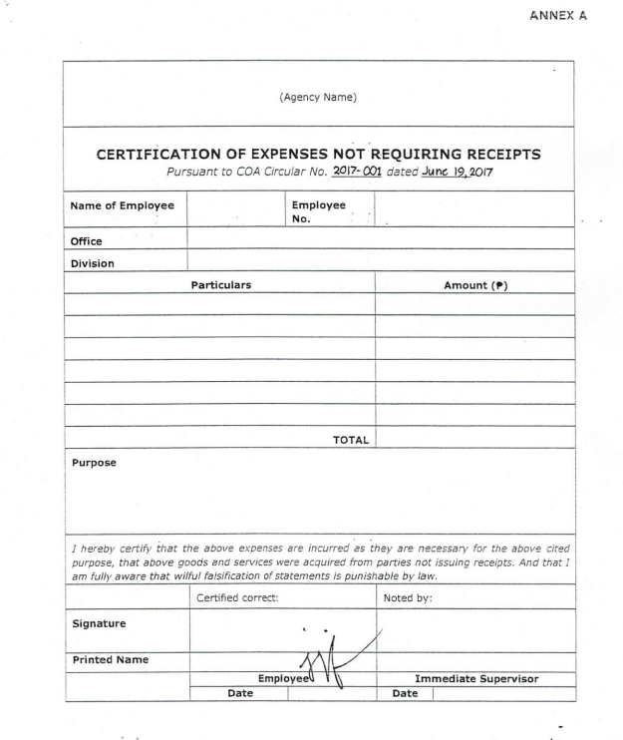
COA Circular 2017-001

Slide 13
NBC No. 567 s. 2017
Guidelines on the release of fund for FY 2017
PURPOSES
To provide policies, procedures, rules and regulations on the release, utilization of funds, and monitoring thereof for FY 2017.
To synchronize fund release with the implementation of the overall physical and financial plans, targets and schedules submitted by the departments, agencies, and/or operating units (OUs).
To institutionalize evidence-based decision-making, streamlined and simplified
monitoring and evaluation and reporting of performance information

Slide 14
NBC No. 567 s. 2017
Guidelines on the release of fund for FY 2017
GENERAL GUIDELINES
The appropriations authorized under FY 2017 GAA shall be valid for release and obligation for the purpose specified and subject to the pertinent special and general provisions:
For Personnel Services (PS) - until December 31,2017.
For Maintenance and Other Operating Expenses (MOOE) and Capital Outlays (CO) - until December 31, 2018.
For Financial Expenses (FinEx) - until December 31, 2018, considering that it is similarly treated as an MOOE.
However, pursuant to Item III.A of the FY 2017 President's Veto Message, all agency heads are directed to ensure obligation of programs, activities and projects funded under FY 2017 GAA not later than December 31, 2017. Failure to do so will adversely affect future budget levels of the respective agency/department.

Slide 15
NBC No. 567 s. 2017
Guidelines on the release of fund for FY 2017
GENERAL GUIDELINES
The following guidelines shall be observed in the use of savings to augment deficient appropriations for P/A/Ps in the FY 2017 GAA:
Savings refer to portions or balances of any released appropriations which have not been obligated as a result of any of the following:
Final discontinuance or abandonment of an ongoing program, activity or project (P/A/P);
Non-commencement of the P/A/P for which the appropriations is released;
Decreased cost resulting from improved efficiency during the implementation or until the completion by agencies of their P/A/Ps:
Difference between the approved budget for the contract and the contract award price including any variations required for the project.

Slide 16
NBC No. 567 s. 2017
Guidelines on the release of fund for FY 2017
GENERAL GUIDELINES
Appropriations for PS shall be used for the payment of personnel benefits authorized by law to be given to National Government personnel, computed based on the Government Manpower Information System (GMIS), as well as any deficiency in authorized personnel benefits that may be determined during the year,
Any available allotment for PS within a department or agency may be utilized by said department or agency for the payment of deficiencies in authorized personnel benefits (GP No. 45 of FY 2017 GAA).
In case there is insufficiency in PS allotment, the department or agency may frontload requirement corresponding to said insufficiency against the unobligated PS allotments comprehensively released.

Slide 17
NBC No. 567 s. 2017
Guidelines on the release of fund for FY 2017
GENERAL GUIDELINES
Appropriations for PS shall be used for the payment of personnel benefits authorized by law to be given to National Government personnel, computed based on the Government Manpower Information System (GMIS), as well as any deficiency in authorized personnel benefits that may be determined during the year,
In the use of available released PS allotments/appropriations, the following limitations shall be observed:
Released allotments which cannot be reallocated to other object of expenditures under PS:
Retirement and Life Insurance Premium (RLIP); and
Special Account in the General Funds (SAGFs), except if expressly authorized in the law creating them.
Available released allotments for PS cannot be used to pay CNA Incentives.

Slide 18
NBC No. 567 s. 2017
Guidelines on the release of fund for FY 2017
GENERAL GUIDELINES
Any deficiency of the agency for the following authorized personnel benefits may be charged against their available PS allotment, to wit:
Deficiency in the provision for authorized Magna Carta benefits provided in the GAA.
Deficiency in specific-purpose allowances and benefits such as overtime pay, honoraria and representation and transportation allowance, among others, subject to existing conditions in the grant of such benefits.
Award of backpay for cases with final and executory decisions of competent authorities such as Courts. CSC, and COA.
Personnel benefits authorized in prior years but only approved for payment during the current year. These benefits shall not be considered as prior years' unbooked obligations.

Slide 19
Taxation
Particulars | 5% | 3% | 2% | 1%
Merchandise
VAT | a |  |  | a
Non VAT |  | a |  | a
Services
VAT | a |  | a
NonVAT |  | a | a

Slide 20
THANK YOU

