Slide 1
SCHOOL-BASED FINANCIAL MANAGEMENT for Non-IU

Slide 2
Session Overview
List of Activities for School-Based Financial Management (SBFM) for Non-Implementing Units (Non-IUs)
Guidelines on Granting of Cash Advances
Practise Set for the preparation of Liquidation Reports for School MOOE

Slide 3
Learning Objective
To improve school performance and to equip the school head with at least the minimum knowledge about concepts, methods and procedures of a simplified fund management system
To have a hands-on experience in the preparation of Cash Disbursement Register (CDR) for the liquidation of School MOOE

Slide 4
School-Based Financial Management (SBFM)
What is SBFM?
School-based Financial Management refer to activities undertaken or pursued by a school head and his/her designated staff who assist in the management of financial and relevant non-financial resources available to the school.
These are pursued aimed at maximizing the benefits that may be derived from the utilization of these resources and minimizing the attendant negative costs or effects of such activities.

Slide 5
con’t... School-Based Financial Management (SBFM)
Activities involved in SBFM are the following, but are not limited to:
1. Fiscal Planning, budgeting
2. Cashiering and disbursement
3. Accounting and recording
4. Procurement
6. Physical and financial reporting
5. Asset and liability management, and

Slide 6
FISCAL PLANNING
Includes the estimation of financial resources a school may get from all sources (i.e GAA budget allocation), local government, PTA donations, income generating projects (IGP), private sector donations and contributions, and all other sources
Includes identifying output or target-setting and identification of activities needed to be undertaken to achieve the outputs and/or targets

Slide 7
con’t... FISCAL PLANNING
Includes matching of resources estimated to be received considering the timing of when the activities must be pursued and when the resources becomes available
A school involves its stakeholders (e.g. Civil Society Organizations (CSO), LGUs, NGO, PTA or School Governing Council, to encourage active participation in the school’s management concerns such as improvement of the learners’ performance and sourcing of needed funds

Slide 8
con’t... FISCAL PLANNING
WHAT IS SCHOOL IMPROVEMENT PLAN (sip)?
SIP a medium term fiscal plan which in essence is the major fiscal planning activity of the school
Covers three (3) years of planned operation
DO No. 44, s. 2015 details the guidelines for the preparation of the SIP
Notes:
Detailed discussion of SIP and AIP have been presented earlier.

Slide 9
School’s Sources of Funds
Implementing Unit | Non-Implementing Unit
Allocation from the national budget downloaded directly by the DBM regional office | Allocation from the national budget downloaded by its division office
Income Generating Projects or IGP (e.g., school canteen, agricultural production, arts and crafts, fund raising activities, etc.)
Donations (PTA, alumni, non-government organizations, private companies, private individuals, etc.)
Other government sources (e.g. SEF, LGU general fund, sponsorship by members of congress from other national funds, etc.)
Other sources
Notes:
The school’s share in MOOE from the national budget is determined by DepEd central office with a formula using EBEIS data on enrollment, number of classrooms, number of teachers, and number of graduates. The latest formula used was referred to as the Boncodin formula with a fixed component, and variable factors for each of the datum identified in the EBEIS. A newly developed formula that considers costs, norms and standards in the delivery of programs and services of DepEd and referred to as the Normative Funding Formula will replace the current one

Slide 10
Other Sources
income earned by national elementary and secondary schools from fees, charges and assessments collected in the exercise of their function such as, but not limited to, certification or authentication of Forms 137 and 138 and diplomas, sale of scrap materials, charges for lost identification cards, and such other services
- income from these source will be used to augment the schools' instructional programs and MOOE. (Special Provision, GAA 2016, Volume III, No. 1, p.268)
Notes:
Disbursements may be made in accordance with the guidelines issued by DepEd and budgeting, accounting and auditing rules and regulations.

Slide 11
Other Sources
income earned by national elementary and secondary schools from manufacturing and production programs, including auxiliary services pursuant to LOI No. 1026 dated May 23, 1980
- income will be used to (1) cover expenses directly incurred in said programs; (2) augment scholarship to students who are directly involved in said programs; and (3) cover student loan essentials to support school-student projects or enterprises. (Special Provision, GAA 2016, Volume III, No. 1, p.268)
Notes:
Disbursements may be made in accordance with the guidelines issued by DepEd and budgeting, accounting and auditing rules and regulations.

Slide 12
BUDGETING
What is School budgeting?
School Budgeting is an annual process that involves matching the estimated resources for the ensuing budget year to the activities that will be funded considering timing of the availability of the resources.

Slide 13
What IS school annual implementation plan (AIP)?
The AIP is also referred to as the school operating budget (SOB).
DO No. 44, s. 2015 contains the explanation and details of AIP.
Notes:
Detailed discussion of SIP and AIP have been presented earlier.

Slide 14
CASHIERING AND DISBURSEMENT
Involves cash management and payments whether by check or in cash
Notes:
Cash management includes not only actual handling but safekeeping of cash funds as well.

Slide 15
con’t... Cashiering and Disbursement
Cash Advances for Operating Expenses of Non-IUs
1
Non-IU schools may be granted Cash Advance covering one month of operating requirements for MOOE to finance their operations
2
It shall be granted only to the duly designated or appointed Disbursing Officer

Slide 16
con’t... Cashiering and Disbursement
Cash Advances for Operating Expenses of Non-IUs
Requirements for the Granting of Cash Advance
Disbursement Procedures for Non-IUs
Liquidation of Cash Advance
(See Appendix 40 form and Instruction of Volume II, GAM)

Slide 17
Disbursement for Non-IUs
Unique feature of cash advance in non-IUs is that liquidation can be made when 75% of the cash advance has been used. The unused balance is not returned but may still be used and liquidated with the succeeding cash advance. In effect the system is a “modified” cash advance system that allows non-IU schools to always have available cash to meet school needs. The cash advance is finally closed at year-end and any unspent balance shall be refunded or re-deposited to the division office.

Slide 18
Bonding of the Accountable Officer
Bond
Is an undertaking that is sufficiently secured
Is one whose duties permits or requires the custody of funds or property for which he is accountable
Bonded Officer (School Head and/or Special Disbursing Officer)
Notes:
An officer whose fidelity bond is insured in the Fidelity Fund, shall, from the moment he/she assumes the office, be considered bonded to the government.
Guidelines for Bonding should be discussed thoroughly in DO/School Level

Slide 19
Duties of Bonded Official
Shall faithfully account for all funds and public property in his/her custody.
Shall exercise control over Cash Advance, collection, as well as lawful payment/ disbursement of all funds transfers in his/her custody
Notes:
Guidelines for Bonding should be discussed thoroughly in DO/School Level

Slide 20
Guidelines for Bonding
1.
Each accountable Officer (The School Head / Special Disbursing Officer) with a cash accountability beyond Php5,000.00 or more shall be insured with the Bureau of the Treasury- Fidelity Bond Division(FBD) as provided under Treasury Circular No. 02-2009 dated 06 August 2009, as previously mentioned;
2.
The Accountable official shall accomplish General Form No. 57A and request for application of fidelity bond to the Bureau of Treasury (BTr) duly signed by the head of the office

Slide 21
con’t... Guidelines for Bonding
3.
Bond Requirement:
2. Statement of Assets, Liabilities and Net Worth (SALN) as of the end of the preceding year; and
3. Certification of No Pending Administrative and criminal case
Note
Items 2 (General Form 57A) and 3 (Bond Requirement), shall be submitted, together with the application for bond, to the Office of the Schools Division Superintendent who shall fix and approve the amount of the bond and transmits the same to the Fidelity Bond Division of the Bureau of the Treasury.
1. Appointment and/or designation as accountable officer. With Character references by at least three (3) officials in the DepEd Division office, who is the Administrative Officer or Legal Officer, other than the appointing/designating official;

Slide 22
con’t... Guidelines for Bonding
4.
When the amount of accountability is increased, we should insure that the bond is also increased;
5.
The Accountable official/employee whose accountability ceases by reason of retirement, separation from the government, promotion, or transfer to another agency, suspension of the office or for any other cause, shall submit immediately a request to the BTr for bond cancellation in the respective CO,RO DO using the General Form 57(A), items 10 - 16;

Slide 23
con’t... Guidelines for Bonding
6.
If the School Head /designated Special Disbursing Officer is already bonded, he/she shall attach a copy of approved fidelity bond certificate on his/her request for cash advance; and
7.
SDO submits the “Requests for Cash Advance” together with approved fidelity bond certificate to the Schools Division Superintendent for his/her appropriate action.

Slide 24
GRANTING OF CASH ADVANCE
The School Head/Special Disbursing Officer submits the “Request for Cash Advance” together with the fidelity bond certificate to the Schools Division Superintendent for his/her appropriate action
The School Head must keep the cash advance in safe or other locked, secure receptacle inside the school premises. Access to the cash advance must be restricted to the School Head

Slide 25
DISBURSEMENT OF CASH ADVANCE
The Cash Disbursement Register (CDReg) attached Appendix 43 Form and Appendix 43 Instructions shall be maintained for each type of cash advance.

Slide 26
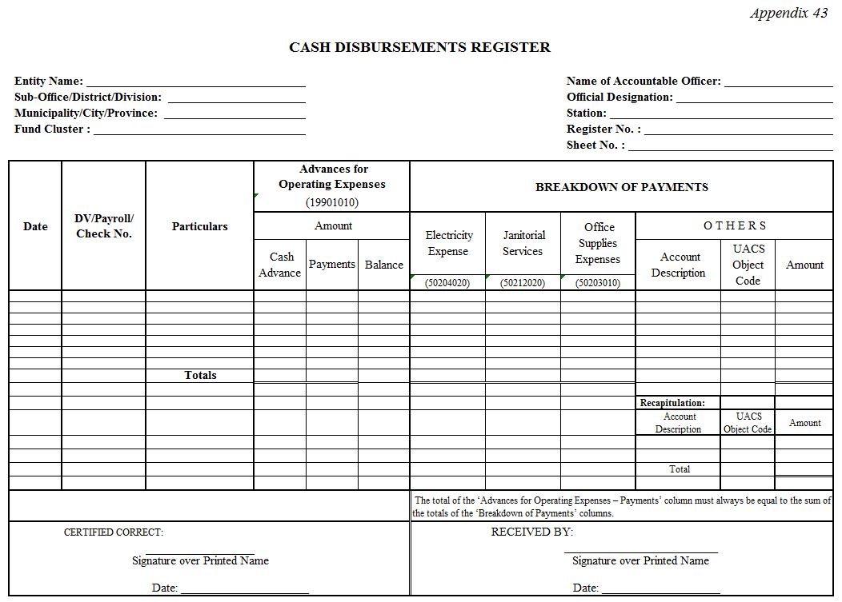
Appendix 43 Cash Disbursement Register
The account on Breakdown Of Payments were modified to adapt to the Non-IUs. (i.e. Electricity Expense and Janitorial Services)
Notes:
The account on Breakdown of Payments were modified to adapt to the Non-IUs.
i.e. Electricity Expense and Janitorial Services

Slide 27
How to Fill-Out the Form?
Notes:
The Sub-Office/District/Division Code is from Unified Accounts Code Structure (UACS)
UACS Code for Division of La Union

Slide 28
con’t… How to Fill-Out the Form?
Notes:
The Station Code is from Unified Accounts Code Structure (UACS)
UACS Code for Ubagan, Sto. Tomas, La Union

Slide 29
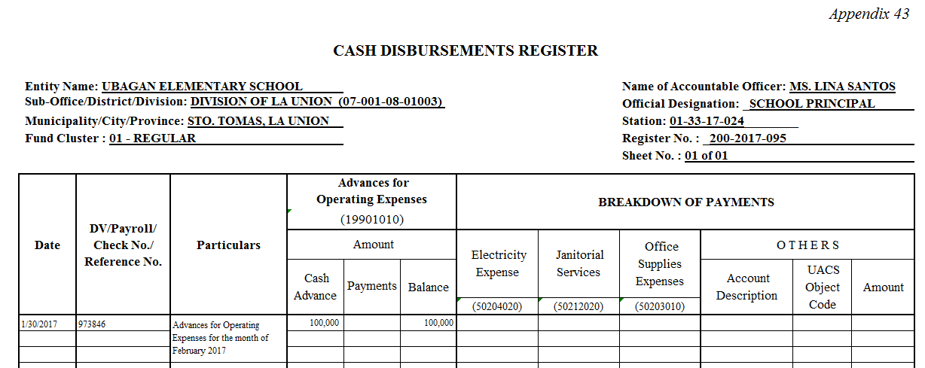
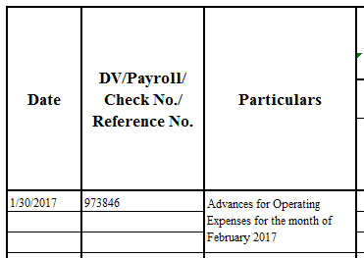
con’t… How to Fill-Out the Form?

Slide 30
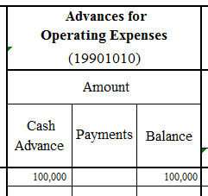
con’t… How to Fill-Out the Form?

Slide 31
Liquidation of Cash Advance

Slide 32
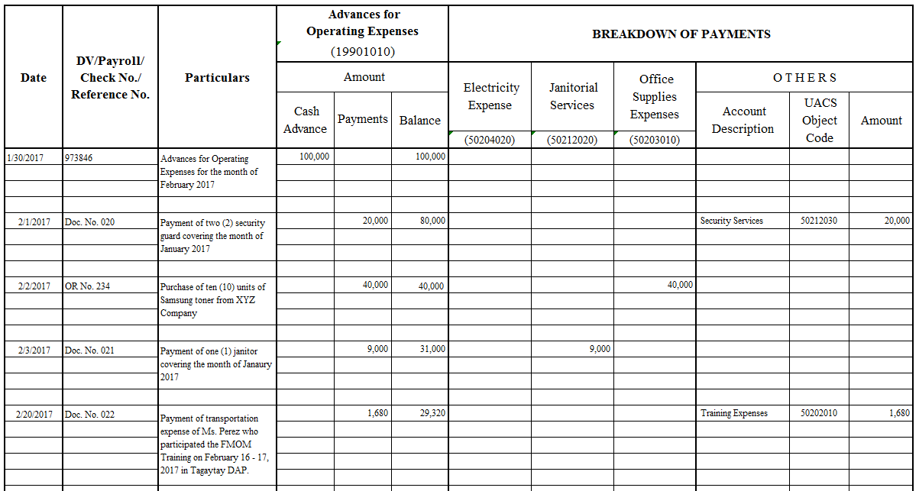
Sample Filled-Out Liquidation
Notes:
Sample filled-out transactions

Slide 33
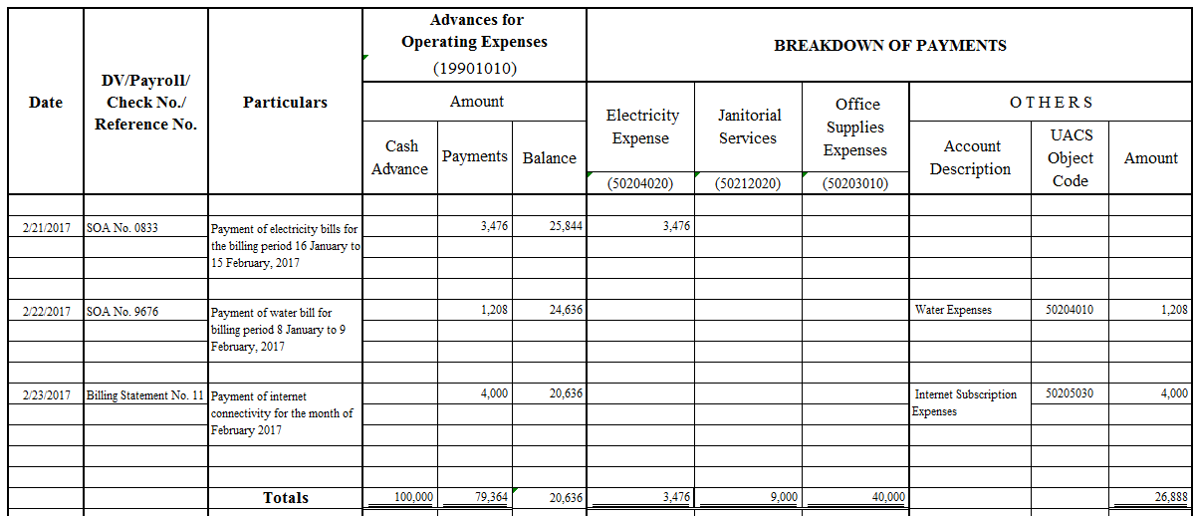
con’t…Sample Filled-Out Liquidation
=
Notes:
Sample filled-out transactions

Slide 34
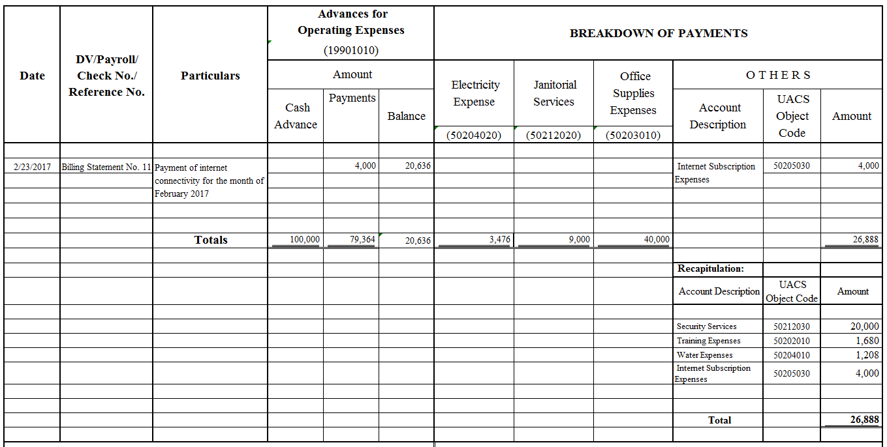
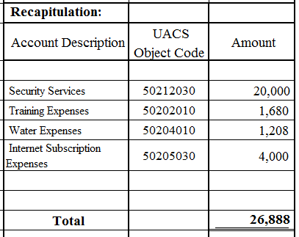
Liquidation of Cash Advance

Slide 35
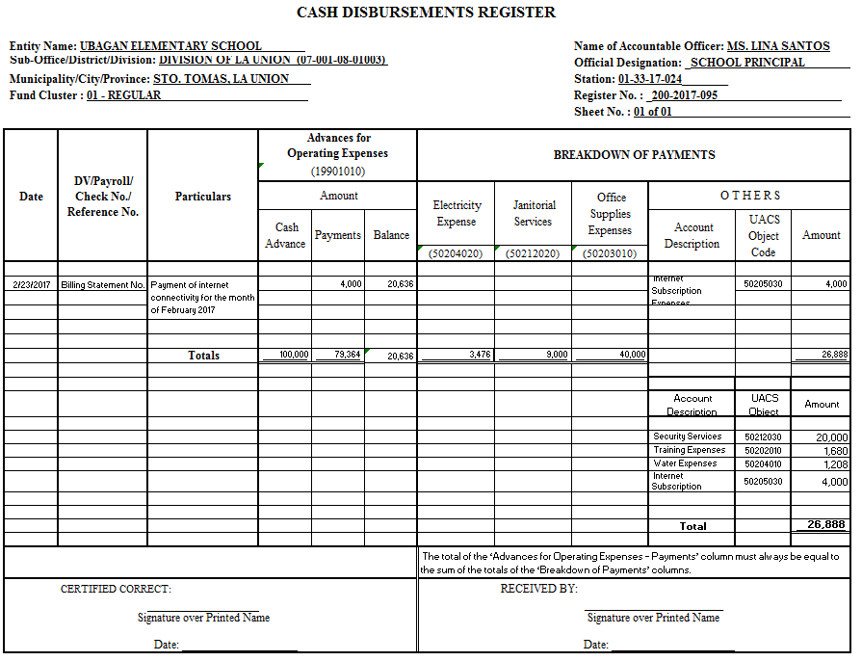
Liquidation of Cash Advance

Slide 36
Liquidation of Cash Advance
Head of the School as Disbursing Officer

Slide 37
Liquidation of Cash Advance
The receiver must check the completeness of this form together with the supporting documents.

Slide 38
Liquidation of Cash Advance
Accounting Unit’s Copy

Slide 39
ACCOUNTING AND RECORDING
Accounting and recording is a necessary activity to be undertaken as resources are received and utilized

Slide 40
con’t... Accounting and Recording
Implementing Unit (IU)
Non-Implementing Unit (Non-IU)
Involves maintaining of books of accounts and rendering of the required financial statements and other reports
IU transactions are audited by COA separately
Involves substantiation of disbursements with the appropriate documentation of transactions made and preparation of the liquidation reports as required for cash advances.
Liquidation reports are submitted to the division office and the transactions are incorporated into the division office books of accounts.

Slide 41
con’t... Accounting and Recording
Part of the accountability phase of financial management for schools is the rendering of physical reports as can be seen in the school report card (SRC).
Refer to DO No. 44, s. 2015 for more details

Slide 42
PROCUREMENT FOR IU
Involves acquisition of needed supplies and materials and other school needs and includes the constitution of a school bids and awards committee (SBAC) and a school inspection committee (SIC)
The presence of SBAC and SIC is very important to ensure impartiality and fairness of the procurement process to deter possible corruption and fraud.

Slide 43
con’t... PROCUREMENT
List of DepEd Orders:
DepEd Order | Coverage
DO No. 13, s. 2016 | Guidelines on the use of school MOOE that applies to schools, particularly the non - IU schools
DO No. 69, s. 2012 and DO No. 45, s. 2015 | Guidelines for utilization of SBM grants that are MOOE funds
As per GAM, school MOOE may be used to procure small value asset below P15,000

Slide 44
Procurement procedures for NON-IUs
1
Preparation/updating of the APP;
2
Identification of both the common-use and non-common-use items by the SBAC Secretariat and preparation of separate lists for each;
3
Performance of the function of the SBAC (conduct of canvass, bidding, etc.) for items not classified as common-use supplies and preparation of the Agency Procurement Request (APR) by the designated Supply/Property Officer for commonly use items to be submitted to DBM-PS in the region where it must be procured;
4
Payment of supplies is drawn from the Cash Advance for School MOOE
Notes:
Procurement Service should discuss the applicable rules on No. 4 on procuring small value OUT OF CASH ADVANCE
In all cases, procurement should be within the approved budget and consistent with the Annual Procurement Plan (APP) prepared by the school.

Slide 45
ASSET MANAGEMENT
Implementing Unit (IU)
Non-Implementing Unit (Non-IU)
Inventory Management
Receipt
Issuance
Recording
Disposal
The initiative lies with the Division Office, since non-IU are part of division office books
School participation is minimal / indirect and only to the extent that the division office require or involve the schools in activities related to this financial management function

Slide 46
Flowcharts on Inventory and PPE
Inventory Receipt, Inspection and Acceptance
Inventory Requisition and Issuance
PPE Receipt, Inspection and Acceptance
PPE Requisition and Issuance

Slide 47
DERECOGNITION OF INVENTORY/PPE
Disposal procedures of unserviceable property shall be in accordance with applicable rules and regulations on Supply and Property Management Manual, and Sec. 79 of P.D. No. 1445.
Original Copy of Inventory and Inspection Report of Unserviceable Property (Appendix 74 (form), Appendix 74 (instruction) will be submitted to Accounting Division as basis of adjusting the affected accounts
Notes:
N0TE: JUST CLICK ON THE LINK P. D NO. 1445 AND APPENDIX 74 (FORM), APPENDIX 74 (INSTRUCTION)

Slide 48
AGRICULTURE
AGRICULTURAL ACTIVITY
is the management by an entity of the biological transformation and harvest of biological assets for sale, including exchange or non-exchange transactions,
for conversion into agricultural produce,
or into additional biological assets.
(Par. 9, PPSAS 27)

Slide 49
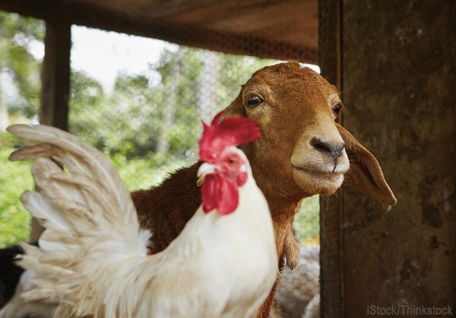
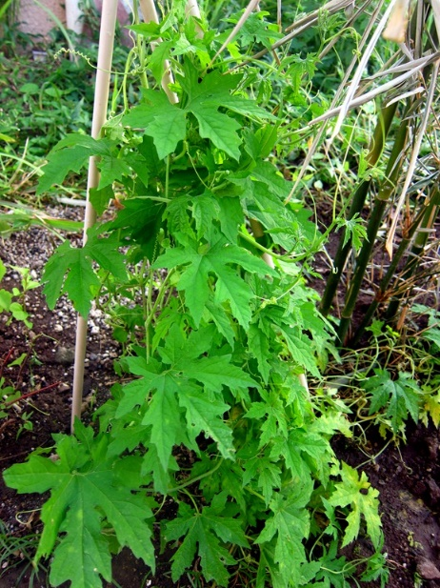
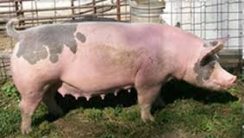
BIOLOGICAL ASSETS
is a living animal or plant. (Par. 9, PPSAS 27)

Slide 50
Classification of Biological Assets
Consumable
Bearer
Held for harvest as agricultural produce or for sale or distribution at no charge or for a nominal charge
Used repeatedly or continuously for more than one year in an agricultural activity
Self - generating

Slide 51
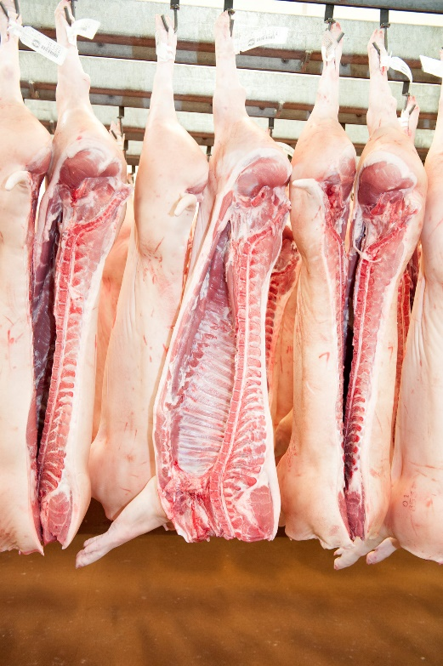
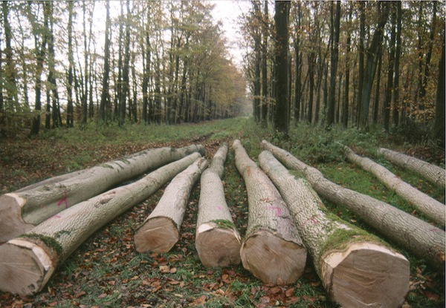
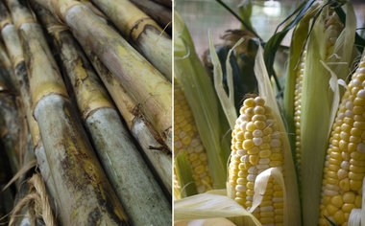
AGRICULTURAL PRODUCE
the harvested product of the entity’s biological assets (Par. 9, PPSAS 27)

Slide 52
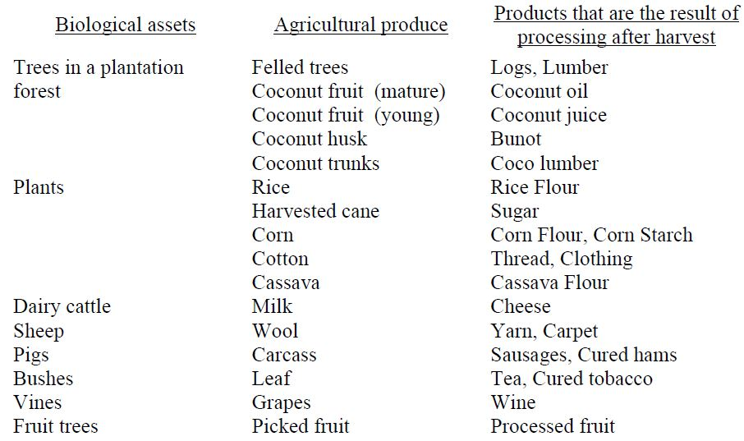
Example of Biological Asset, Agricultural Produce and Products

Slide 53
Measurement
A. Biological Assets
1. Initial Recognition and at each reporting period
Fair value (FV) less costs to sell
2. FV is clearly unreliable
Cost less any accumulated impairment losses

Slide 54
con’t... Measurement
B. Agricultural Produce
Fair Value less cost to sell at the point of harvest

Slide 55
Determination of Fair Value
1
Group according to significant attributes
2
Existence of contracts
3
Deduct from the fair value of combined assets
4
Existence of the active market

Slide 56
con’t... Determination of Fair Value
If an active market does not exist:
1.
Recent market transaction price
2.
Market prices for similar assets
3.
Sector benchmarks

Slide 57
PHYSICAL AND FINANCIAL REPORTING
School report card (src)
SRC is the main document that is prepared to show information on accomplishments and financial resources

Slide 58
con’t... PHYSICAL AND FINANCIAL REPORTING
IMPORTANCE OF SRC
The SRC is a document to communicate to all school stakeholders the status of the school and the conditions under which it operates.
2
It is meant to encourage more participation in terms of support that may be given by stakeholders in whatever form as well as acknowldege that which they have already given
1
DO No. 44, s. 2015 details the guidelines on the preparation of the SRC

Slide 59
con’t... PHYSICAL AND FINANCIAL REPORTING
Deped order no. 44, S. 2015
Aims to standardize reporting done by schools as well as guide and encourage schools to pay particular attention to certain items of interest to management and all other stakeholders

Slide 60
con’t... PHYSICAL AND FINANCIAL REPORTING
In accordance with RA 9485 (Anti-Red Tape Act of 2007), schools are mandated by law to have a Transparency Board on MOOE posting all school expenditures using the allocated funds.
The transparency board must be located in a place open to public view and frequented by the school’s stakeholders

Slide 61
Hands-On Exercise
PRACTICE SET
Notes:
Click Practice Set to open the link or see attached file Activity Practice Set

Slide 62
Thank You!

