Slide 1
Republic of the Philippines
Department of Education
SOCCSKSARGEN REGION
Using app.mover.io to copy/backup data from Google drive to Microsoft OneDrive
Address: Regional Center, Brgy. Carpenter Hill, City of Koronadal
Telefax No.: (083) 2288825/ (083) 2281893
Website: depedroxii.org Email: region12@deped.gov.ph
DepEd SOCCSKSARGEN Region

Slide 2
Session 3: Managing Data-based System (e-portal)
app.mover.io
https://kinsta.com/blog/google-workspace/

Slide 3
TERMINAL OBJECTIVE
Mover.io is a web-based app that offers free migration service for cloud storage data. The service was acquired by Microsoft and has a familiar file structure interface that makes moving content from one platform to another relatively easy.

Slide 4
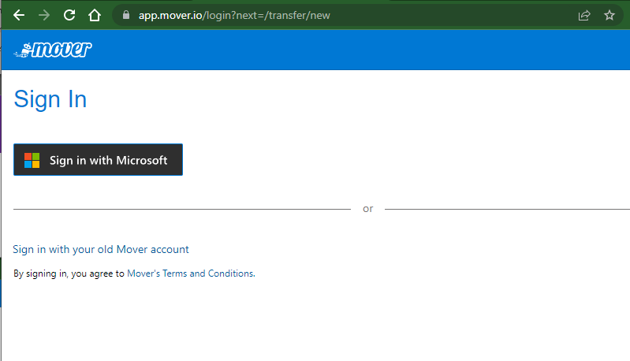
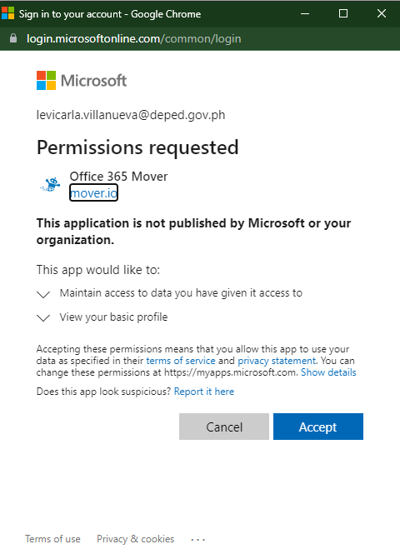
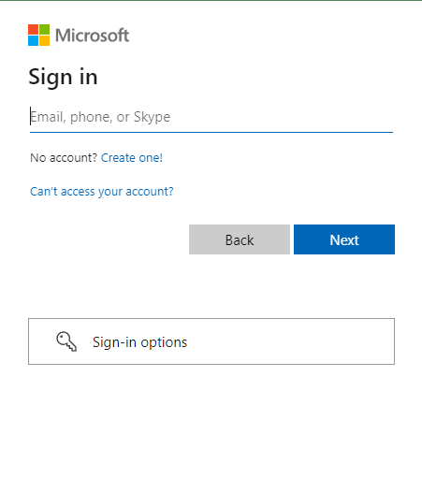
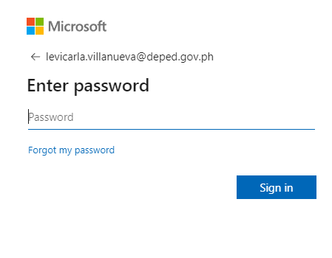
Signing in using Microsoft account
Step 1
Step 2
Step 3
Step 4

Slide 5
Linking your Google account
Click to login to your google account

Slide 6
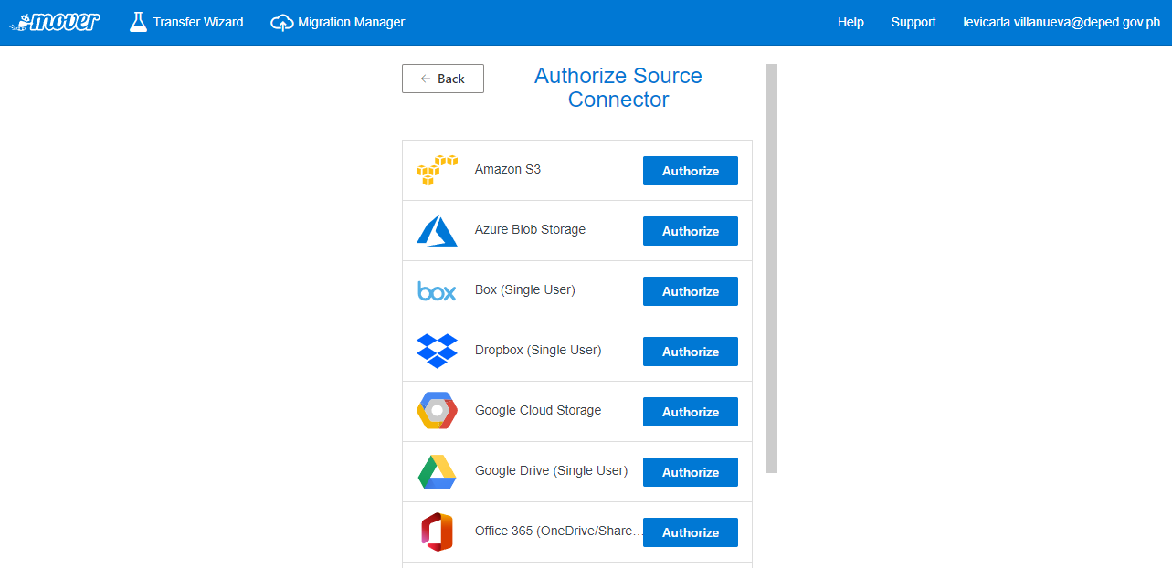
Linking your Google account
Click to authorize mover.io to login your google account

Slide 7
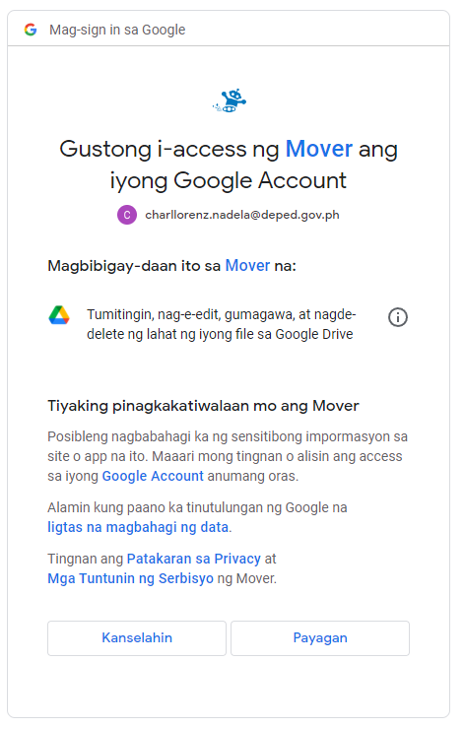
Linking your Google account
Step 2 – Choose your google deped account
Step 1
Step 3 – Click to allow

Slide 8
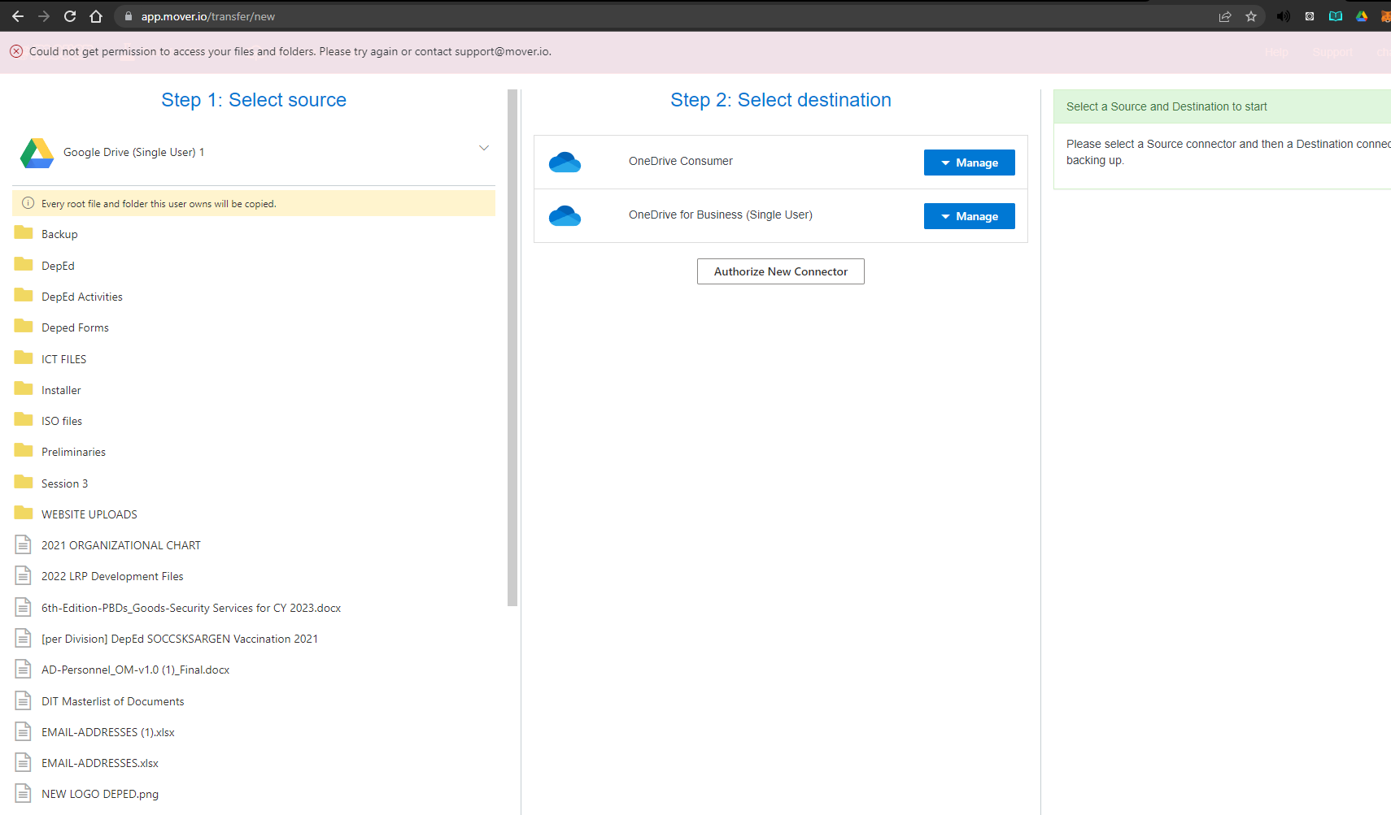
Linking Microsoft Account
Click to authorize mover.io to login Microsoft account

Slide 9
Linking Microsoft Account
Step 1
Step 2
Step 3 – Sign in using Microsoft Account
Step 5 – Input Password
Step 7 – if you’re using your own pc or laptop click yes
Step 4
Step 6

Slide 10
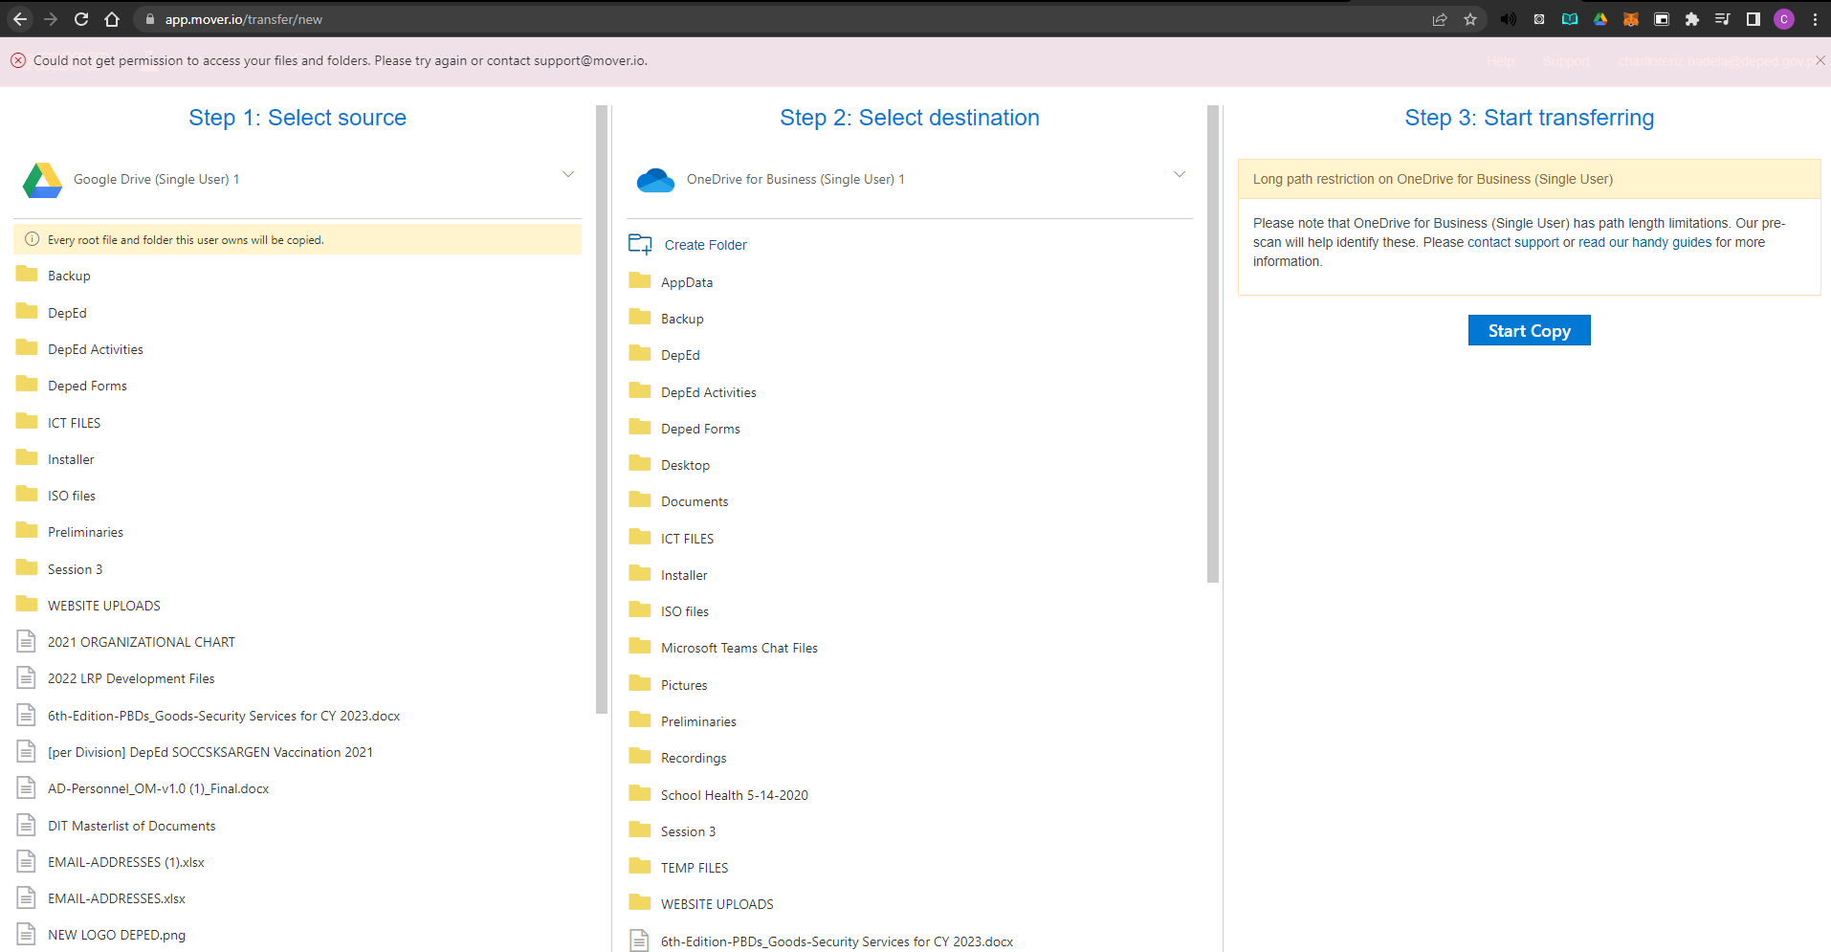
What you see when you linked all accounts
You can select a folder to copy to the destination or keep it default to copy all files and folders
You can create a folder for a new destination you want the source to be saved to or keep it default and all files and folders will be saved on the root folder of your Onedrive
Click Start copy to start the migration

Slide 11
What you see when you linked all accounts
What is displayed after you click start copy
NOTE: Please do not close the window until it’s still not finished migrating.

Slide 12
https://www.deviantart.com/camtyox/art/Thank-You-GIF-749960765

